Slide 1
Avian Influenza – an update
Hon S. Ip
USGS National Wildlife Health Center
This information is preliminary and is subject to revision. It is being provided to meet the need for timely best science. The information is provided on the condition that neither the U.S. Geological Survey nor the U.S. Government shall be held liable for any damages resulting from the authorized or unauthorized use of the information.

Slide 2
Outline
Current situation
How did it get here?
What’s happening in mammals?
What does it all mean?
Source: DVL
Preliminary Information - Subject to Revision. Not for Citation or Distribution.
Notes:
First thank you for the opportunity to present to this group.
Here is what I thought I would cover today.
First, a brief overview of the current situation
And then I will try to answer three questions.
How did the HPAI H5N1 virus get here?
What is with all the mammalian detections?
And what does it all mean? for the birds? poultry? mammals? and people.

Slide 3

You are here (. )
Paraguay
Source: MAFF (Japan) 5/17/23.
Notes:
In some of my slides, I am going to use this little map symbol to show what the current situation looks like.
So, we are here. We are in the middle of the largest avian influenza epizootic on record.
This is a map from the Japanese Ministry of Agriculture, Fisheries and Forestry.
In red are the countries that have been affected by H5N1 since 2022.
You can see that many countries in Asia, Europe, Africa, North and South America have been affected.
In early May, the introduction of HPAI H5N1 into South America has reached its eastern coast with confirmations in Brazil and Uruguay.
<sub click>
This map was generated on May 17th, two days later Paraguay reported confirmations to WOAH.
Map from: https://www.maff.go.jp/j/syouan/douei/tori/#4

Slide 4
Situation in the US (As of 6/1/23)
Poultry: 836 flocks (325 commercial & 511 Backyard) in 47 states.
Wild Birds: 6,922 birds in 154 species from 49 states
Mammals: 191 animals in 19 species from 24 states
Situation in the EU (as of 4/28/23)
2,761 outbreaks in poultry
3,923 detections in wild birds
> 20 mammals in 11 species
37 European countries
Introduction into C. & S America
Oct 2022. Columbia, Mexico
Nov 2022. Ecuador
Dec 2022. Chile, Peru
Jan 2023. Bolivia, Human case in Ecuador
Feb 2023. Guatemala. Argentina, Uruguay
Source: USDA, WOAH, FAO
Notes:
The scale of the outbreak is unprecedented.
In the US, since February of 2022, over eight hundred farms in 47 states have tested positive. A total of over 50 million birds have been culled as part of the country's response.
There has been over six thousand detections in wild birds from every state with the exception of Hawaii. These detections have come from an incredible list of 154 different species, with the most recent addition being the California condor.
And for the first time, we are seeing an extensive detections in wild and even domestic mammals.
subClick
The situation in Europe is very similar.
28 countries have been affected with a similar pattern of detections in poultry, wild birds and mammals.
subClick
and for the first time, the HPAI incursion into North America have extended into Central and South America.

Slide 5
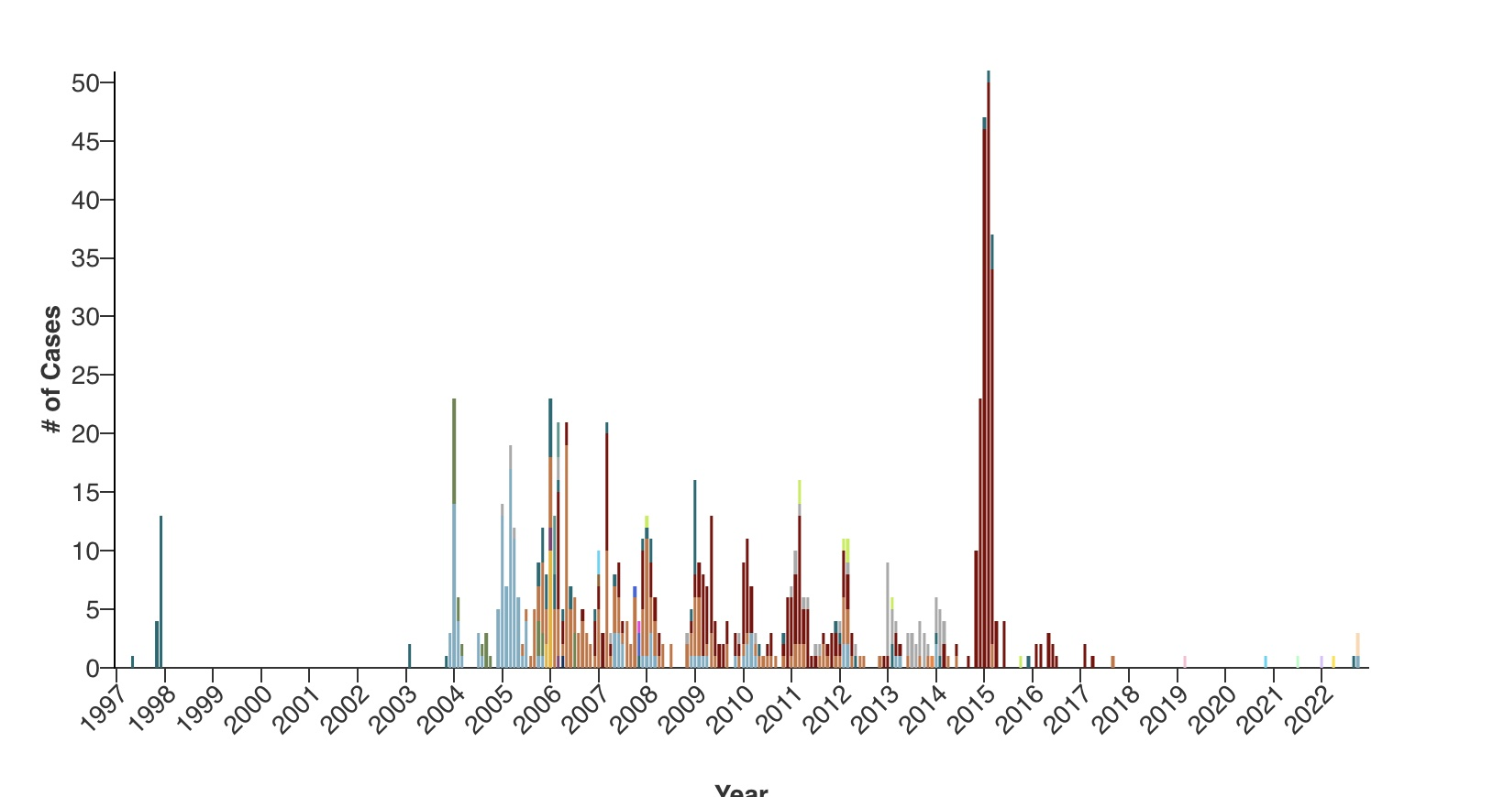
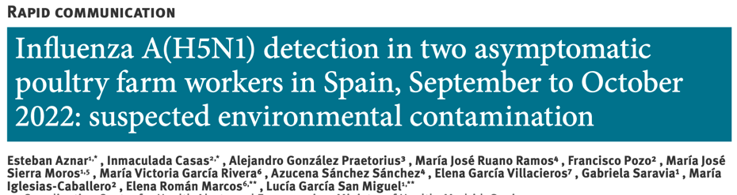

Human H5N1 cases since 1996
Of the 872 confirmed cases, 458 (52.5%) have been fatal.
Of the 870 confirmed cases, 457 (52.5%) have been fatal.
Source: CDC: https://www.cdc.gov/flu/avianflu/chart-epi-curve-ah5n1.html.
Notes:
The bar chart is from the CDC and lists the number of human H5N1 cases since 1996. The map symbol points to the recent human cases in 2022.
Over all, a total of 870 individuals have been infected with H5N1, with over half of the infection being fatal.
subclick
Since 2022, there has been 11 human infections with H5N1, all were from infection with viruses from clade 2344b, with the exception of the two Cambodian cases which were due to a clade 2321c virus.
Most infections with 2344b viruses have been mild or even asymptomatic but there has been at least one death in a 38 YO woman in China’s Guangxi province.
Subclick
A study that you might want to keep in your back pocket is from Aznar et al in Eurosurveillance. They suggest that the two Spanish cases were due to environmental contamination during the collection of the nasal swabs and the two men were not actually infected. The Ct in the nasal swabs were high, the men had no symptoms, and never sero-converted. The paper goes on to suggest that other recent cases, might be also examples of environmental rather than true infections.
See also WHO table is available here: https://cdn.who.int/media/docs/default-source/influenza/human-animal-interface-risk-assessments/cumulative-number-of--confirmed-human-cases-for-avian-influenza-a(h5n1)-reported-to-who--2003-2023.pdf
.

Slide 6
Outline
Current situation
How did it get here?
What’s happening in mammals?
What does it mean?
Source: DVL
Preliminary Information - Subject to Revision. Not for Citation or Distribution.
Notes:
In thinking about the question of how did the virus get to the US
or the broader question of how did we globally got ourselves into this situation,
We need to take a step back and talk about Guangdong H5N1.

Slide 7
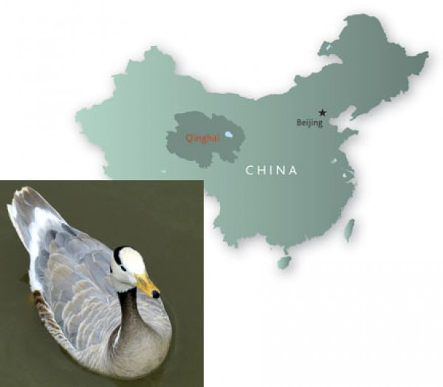
Emergence of HPAI H5N1
1996. First identified in a goose in Guangdong.
1997. 1.7 million poultry culled in Guangdong.
1998. 12 cases in HK.
1999. New NS variant identified in Guangxi.
2001. Major outbreaks in China.
2003. Human cases in HK. (ROK)
2004. 50 outbreaks in China (13/50 provinces) + adjacent countries (ID, JP, LA, MY, VN, TH)
2005. Qinghai.
Notes:
When we say that the current clade 2.3.4.4b H5N1 virus belongs to the Guangdong lineage,
We are talking about a strain of H5N1 virus that emerged in the southern Chinese province of Guangdong (here marked with a red star) in 1996.
A number of human cases were detected in the early years after 1996.
But the main thing to note is that the virus was able to spread unabated during these early years in China and into surrounding countries like Indonesia, Japan, Laos, Myanmar, Vietnam and Thailand.
Then in 2005, Qinghai happened.

Slide 8
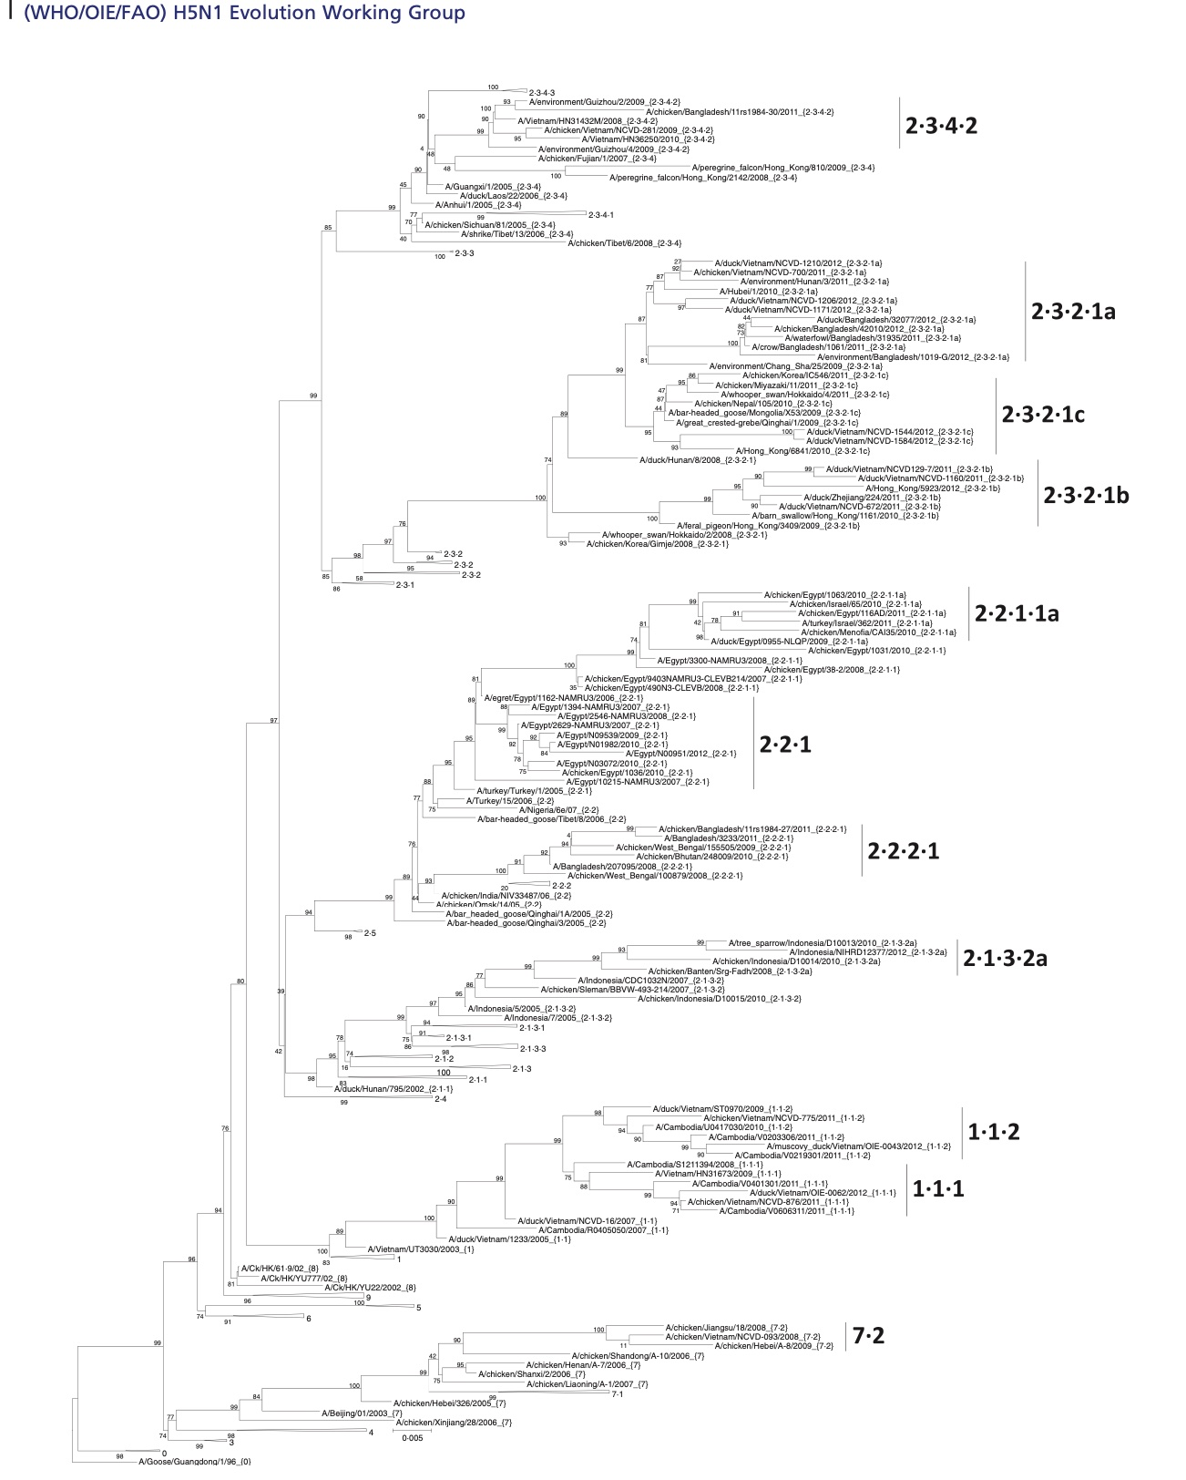
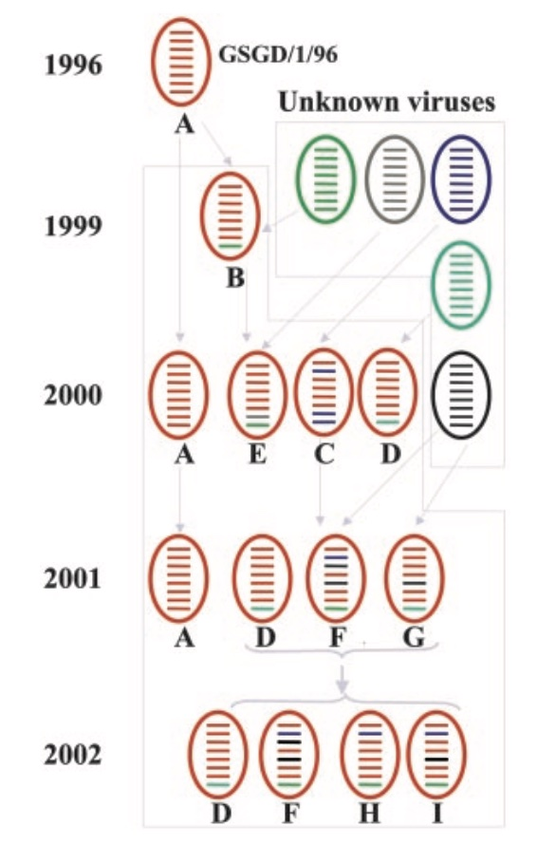
HPAI H5N1 – the cast of characters
2.3.4.4
What does the term Guangdong Lineage H5N1 mean?
How does clade 2.3.4.4 b H5N1 fit into the Guangdong Lineage family tree?
Source: Gavin et al. (2014. IAORV 8:384-388.)
Notes:
So, what does the term Guangdong lineage mean?
and how does clade 2.3.4.4b fit into the Guangdong lineage?
Are there other avian influenza viruses of concern?
sub click
For answers we can look how the H5N1 virus it has evolved since 1996.
The blue arrow points to the original 1996 Guangdong virus. It is at the base of this phylogenetic tree of H5N1 lineages.
This virus has evolved and changed significantly since 1996.
Some of the members of this family has emerged and died out,
and new lineages appeared.
Because all of these viruses are H5N1, a group led by the WHO has developed a formal structure to label the clades and subclades by a series of numbers and decimals.
sub click
But this already complicated phylogenetic tree only tracks the hemagglutinin or HA gene of the virus,
and the HA is only one of 8 RNA segments that makes up the viral genome.
On this cartoon on the left, the 8 RNA segments are color coded with different colors to represent different lineages.
I hope you can see that the original Guangdong virus has recombined and taken on RNA segments from avian influenza viruses from both poultry and wild birds sources
to generate multiple different viruses that might co-circulate in any given year.
subclick
This phylogenetic tree in no ways capture the entire genetic diversity of H5N1, and in fact the clade that really concerns us today, the 2344 clade is not even on this tree.
As a side note, the strain of H5N1 that killed the 11 YO girl in Cambodia last week belonged to clade 2.3.1.3c. That group of viruses is highlighted by the red oval.
I point this out because as we are focused on clade 2344b H5N1, the Cambodian cases should be a reminder that other avian influenza viruses are out there that may poses threats to agriculture and to public health.
Reassortment schematic from: Chen et al. (2004. PNAS 101:10452-10457).

Slide 9
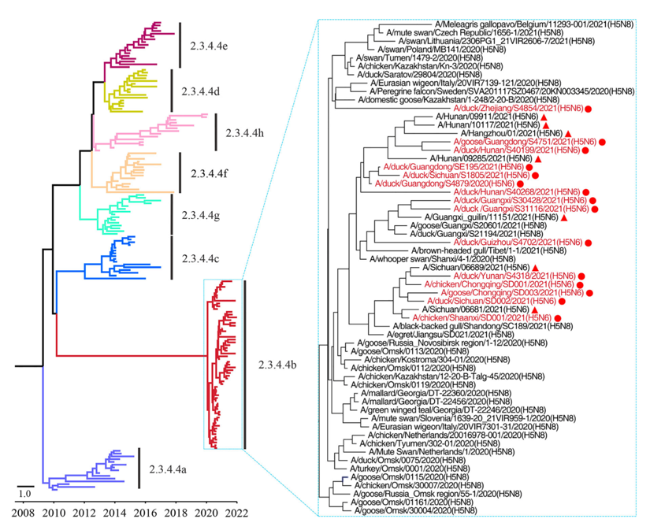
HPAI H5N1 – Clade 2.3.4.4
Xyz
Source: Gu et al. (2022. Emerg Microb Infect 11:1174
Notes:
And even if we focus just within the 2344 clade, there are multiple sublineages.
We have been concerned with the emergence of clade 2.3.4.4b viruses since 2022
But I thought I should point out that the HPAI introduction into US and Canada in 2014 was from a clade 2.3.4.4c virus, here also highlighted by a red oval.
Yet again demonstrating that there is a constellation of threats out there.

Slide 10
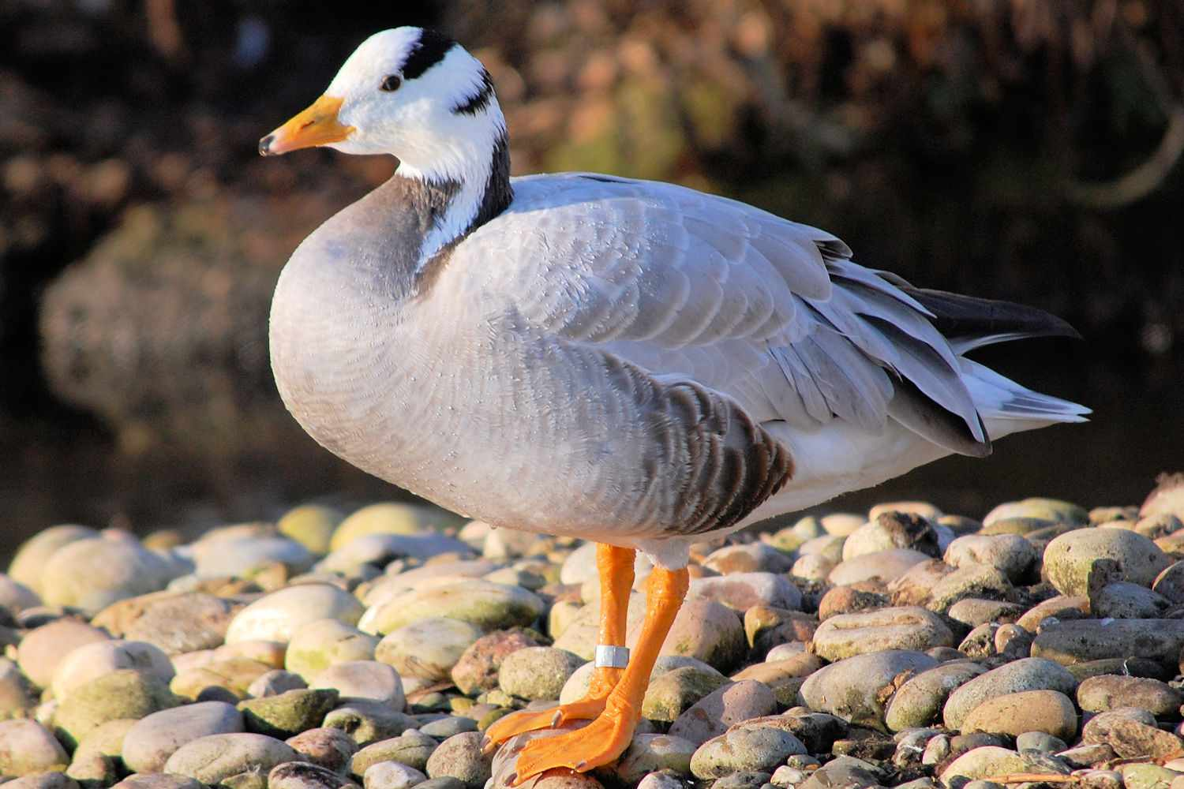
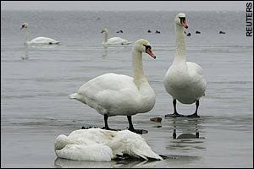
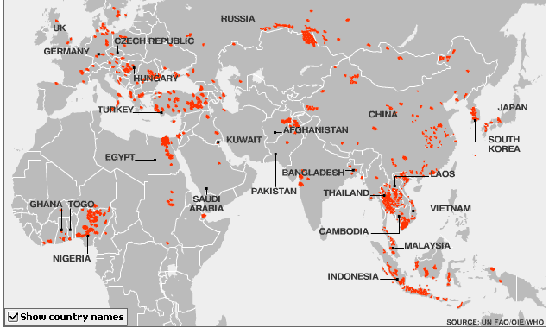
Large Scale Spread of H5N1 in 2005
Source: http://goo.gl/nCxCw
Notes:
10
Going back to the Guangdong H5N1, most of the rest of the world came aware of the virus, when in 2005, the virus spread out of southeast Asia into Central Asia, Africa and Europe.
The poster children of this first large-scale geographical spread of H5N1, to my mind, were the thousands of bar-headed geese that died in Qinghai, China and the mute swans that died in Europe over the 2004/2005 winter.

Slide 11
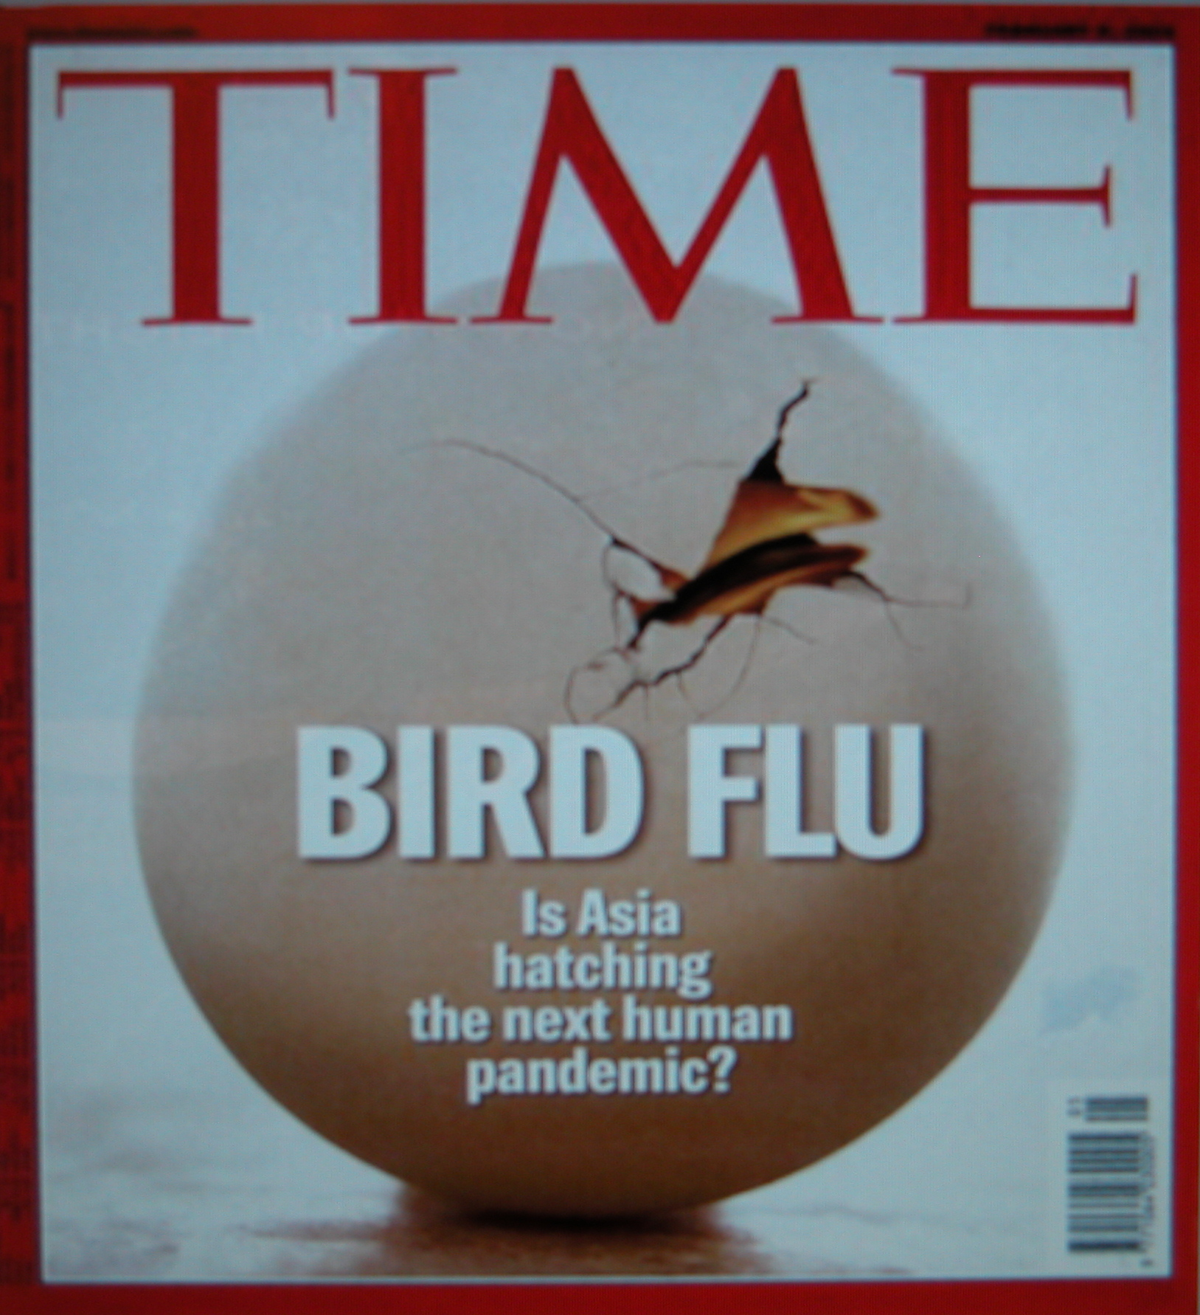
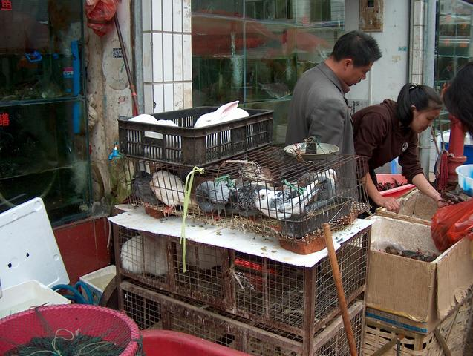
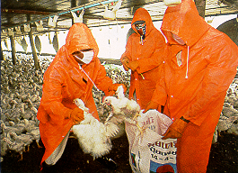
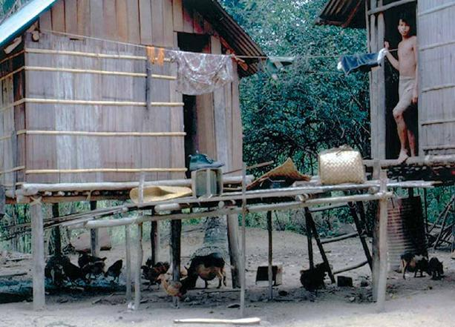
Will H5N1 become the next pandemic virus?
Source: http://goo.gl/nCxCw
Notes:
11
That year the virus made to the cover of Time magazine, and nearly twenty years later, we are asking the same question
– whether bird flu will become the next pandemic virus and if so from where will that first strain emerge?

Slide 12
Focus on the Behring Strait & Alaska as possible introduction routes
Check, 2006. Nature 442:348-350.
Notes:
In 2005, the rapid and long distance spread of H5N1 from China westward into Africa and Europe raised the question of whether the virus could also spread eastward into North America.
Because of the overlap of the East Asia/Australia flyway and our Pacific flyway overlap in Alaska,
it made the region around the Behring Strait a likely area where such an introduction would occur.
Of course, we now know that the 2005 expansion did not extend into North America.
I should note that around this time, there was active debate that while some species of birds are known to migrate across the Behring Strait,
the existence of a very distinct genetic lineages of Eurasian versus North American wild bird avian influenza viruses argue that the extent of intercontinental movement of AI viruses was limited.
But boy did HPAI viruses have something to say about intercontinental transmission.

Slide 13
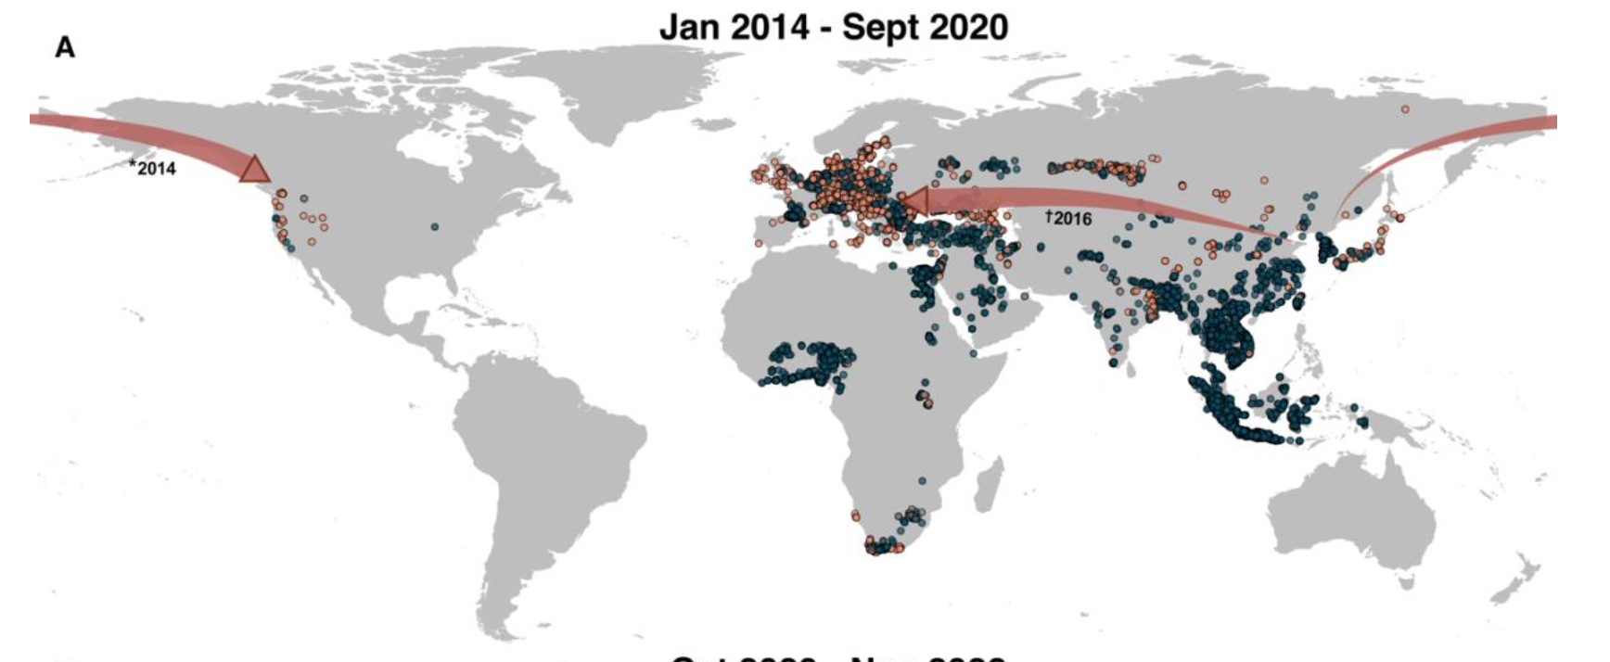
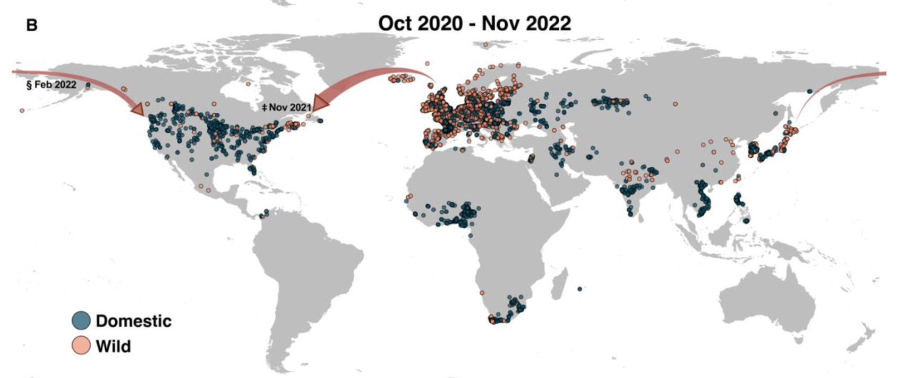
HPAI Introduction into North America
txt
Source: Harvey 2023. Preprint.
Notes:
As you know, a HPAI H5N8 variant that first caused outbreaks in the spring of 2014 in Japan and South Korea lead to the introduction of that virus into US and Canada later in the same year.
That introduction most likely occurred via the Behring Strait, but it was not detected during the surveillance during the summer in Alaska,
My lab was among the first to detect the introduction in December 2014 from wild birds that was submitted to us from Washington State.
The introduction of H5N1 that is the cause of the present outbreak was first detected in eastern Canada, in Newfoundland in November 2021,
and the first US detection followed soon after in January of 2022 in first North and then South Carolina.

Slide 14
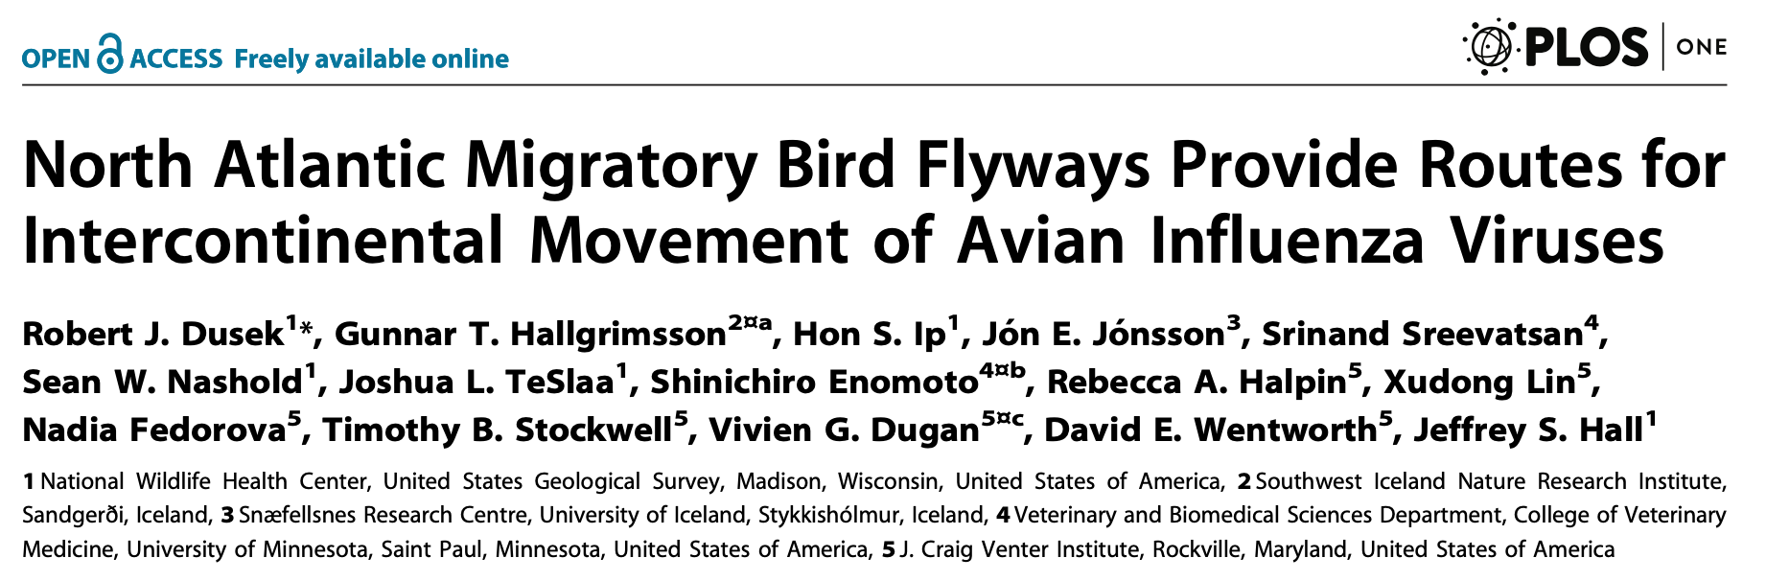
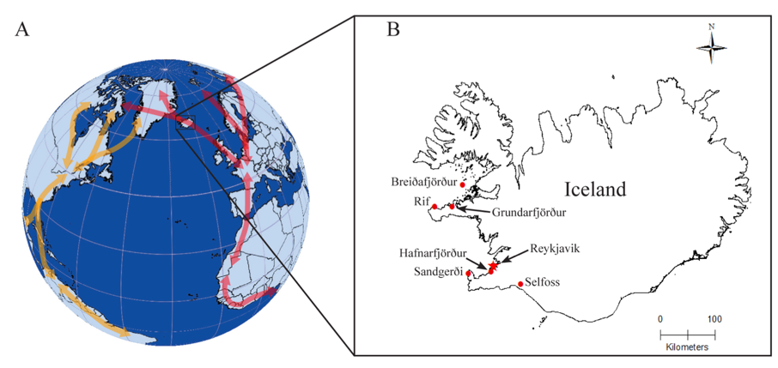
The North Atlantic Route
The Behring Strait and Alaska dominates the discussion on AIV introduction, but…
Source: Dusek et al. 2014. PLoS One 9:e92075
Notes:
I would argue that the introduction from the Atlantic side and not via Alaska was not unexpected, as my group had shown in 2014, that Iceland and Greenland are important areas where birds from North America and Europe interact and of course exchange whatever viruses they might be carrying.

Slide 15
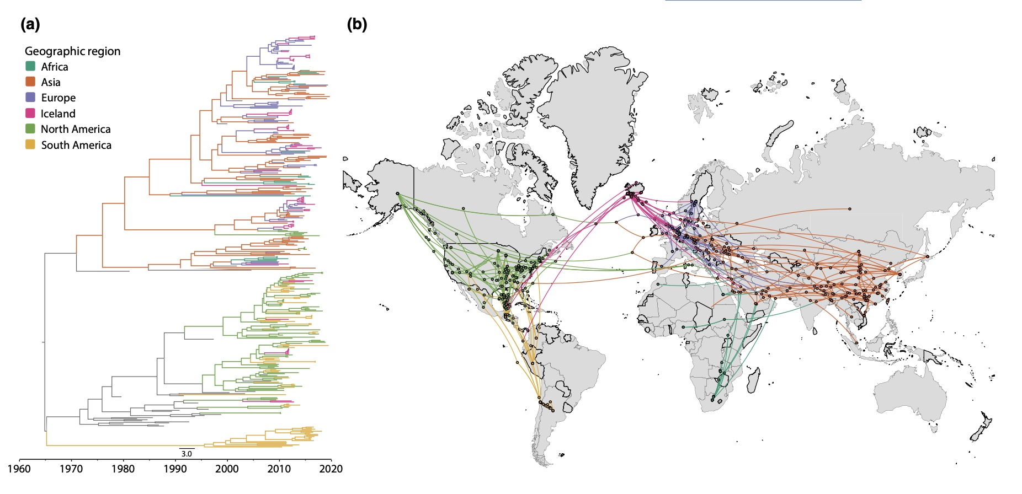
The North Atlantic Route
The Behring Strait and Alaska dominates the discussion on AIV introduction, but…
Source: Gass et al. (2021. Molec Ecol 32:198-213.)
Notes:
Since then additional studies have supported the idea of the north Atlantic route of introduction.
Here is an example from Gass et al. with sequences from additional avian influenza viruses tracing viruses from Europe into US and Canada
and even into Central and South America.

Slide 16





What has happened since the introduction?
Source: USDA
Preliminary Information - Subject to Revision. Not for Citation or Distribution.
Notes:
One of the things that has happened since the introduction is that the virus has reassorted with North American lineage avian influenza viruses.
Many of you have seen language like this in the NVSL reports.
HPAI was determined by analysis of the protease cleavage site.
EA 2344 H5 are viruses that are direct descendants of the introduced strains.
and a variety of EA/AM reassortant where the virus is a genetic combination of the introduced H5N1 and some North American wild bird avian influenza virus.
The NVSL reporting language gives a succinct description of which segments are from North America.
But this is not the complete story, I've circled the PB1 gene as in reading the reporting language, you would not know that at least four different North American virus lineage have been swapped into HPAI H5N1.

Slide 17
What has happened since the introduction?
Source: Tawidian and Ip.
Preliminary Information - Subject to Revision. Not for Citation or Distribution.
Notes:
A more comprehensive way to visualize what has happened following the introduction of H5N1 is via a phylogenetic tree.
Thanks to the sequencing group at NVSL, thousands of viruses from the outbreak has been sequenced.
The figure represents the 130 H5N1 viruses from wild birds that I have submitted to NVSL over this past year and combined it with a selection from the thousands of viruses that USDA has sequenced.
You don't need to read the virus' names, but I hope you can see that they fall into clusters and I have named and colored them in shades of green and blue according to the figure legend to the left.
My samples form into 14 different clusters, but there are probably more once the entire USDA dataset is analysed.
And before I leave this slide, viruses in the group G5 and G9 are the strains that have made it into Central and South America.

Slide 18
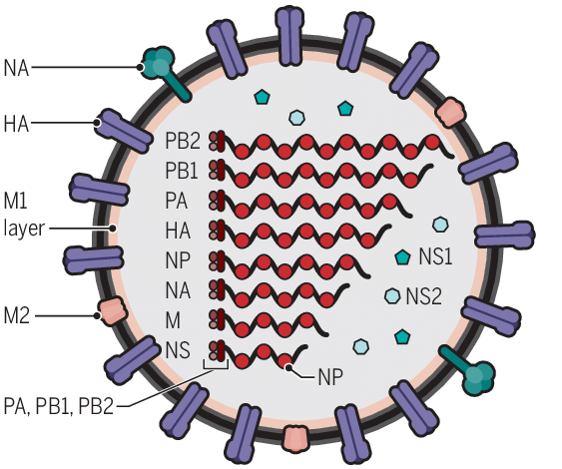
Vast array of reassortment
PB1 (Segment 2)
At least 12 different genotypes
Recombine, evolve, change in prevalence
Source: Tawidian and Ip
Preliminary Information - Subject to Revision. Not for Citation or Distribution.
Notes:
Those phylogenetic trees gets hard to read when there are too many viruses on them.
And on this figure to the left, my postdoc Patil Tawidian have come up with a different way of visualizing the genetic differences.
Here the circles enclose groups of viruses that have very little genetic difference between them. Each cluster may contain many viruses,
but by clustering them this way we can begin to highlight the viruses that are genetically different. We think that presenting the data this way will allow us to focus on those viruses, such as these dots that are not within the four circles. Because these outliers have new reassorted gene segments and as a result they might have interesting biological properties conferred by their new genetic composition.
SubClick
Another way of showing the range of genetic differences is on the table to the right.
Genotype A1 is the virus that was introduced on the East Coast of the US early in 2022. I’ve colored all 8 of that virus’s RNA segments in blue.
Then whenever you see a color change down a column, it means that those viruses have acquired an RNA segment from a different lineage.
So, the A2 genotype viruses, for example, have a PB1 gene that is from a North American wild bird lineage.
And if you continue down the same column, each new colors mean that a different PB1 gene have been inserted into the H5N1 virus.

Slide 19
Outline
Current situation
How did it get here?
What’s happening in mammals?
What does it mean?
Source: DVL
Preliminary Information - Subject to Revision. Not for Citation or Distribution.
Notes:
Before I talk about the situation in mammals

Slide 20
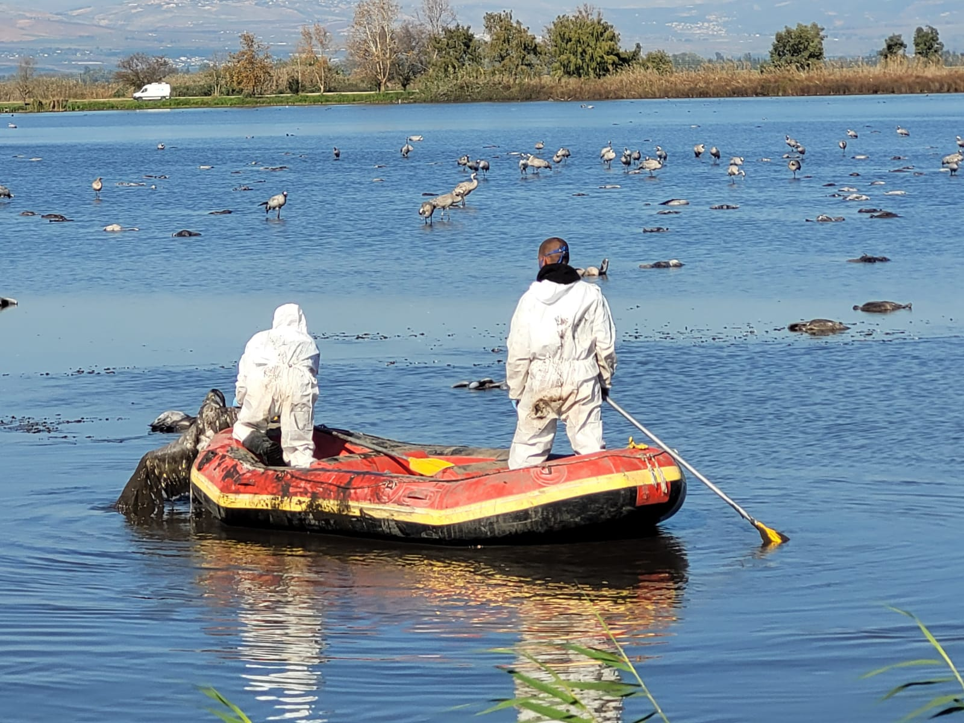
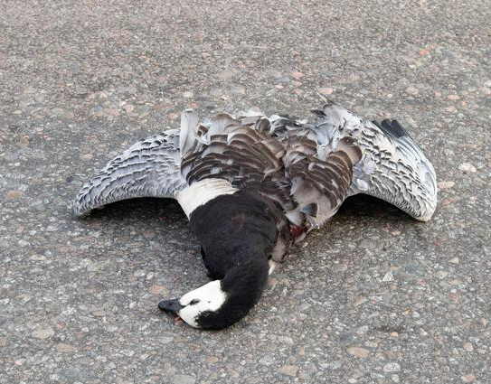
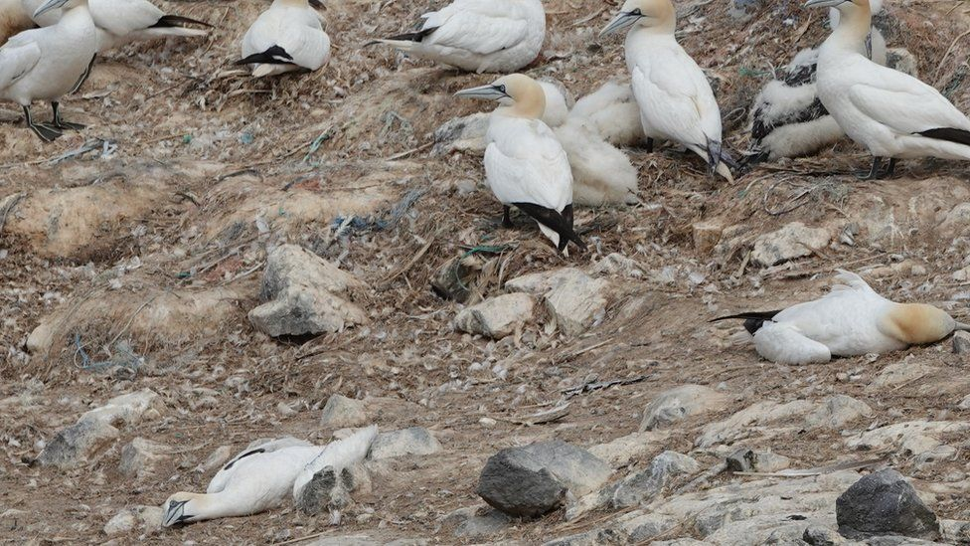
Mass wild bird mortalities
Cranes. Israel. Over 5,400 (17%) Eurasian crane died in Israel
Barnacle geese. 10% of of the Svalbard and 40% of the Scottish population has died.
Northern Gannets. 10% of the global population has died. Including in NA.
Pictures: Times of Israel/Alamy/BBC
Notes:
I want to briefly mention that this HPAI H5N1 outbreak has had significant population scale impact on wild bird populations around the world.
In northern Israel, nearly 20% of their wintering population of Eurasian cranes died early last spring.
10% of the Barnacle geese population that breeds in Svalbard has died this summer and overall, 40% of the entire Scottish population of barnacle geese has died.
In the colonial bird breeding colonies, such as those occupied by the northern gannets, H5N1 spread like wildfire and in all 10% of the global population has died
Closer to home, since early April we are finding out the H5N1 is making an impact on the California condor species restoration effort.
Photo credits:
https://www.timesofisrael.com/grim-cleanup-of-cranes-that-died-of-bird-flu-begins-in-hula-valley-reserve/
https://www.alamy.com/dead-barnacle-goose-lying-on-street-image437242169.html
https://www.bbc.com/news/uk-wales-62426144

Slide 21
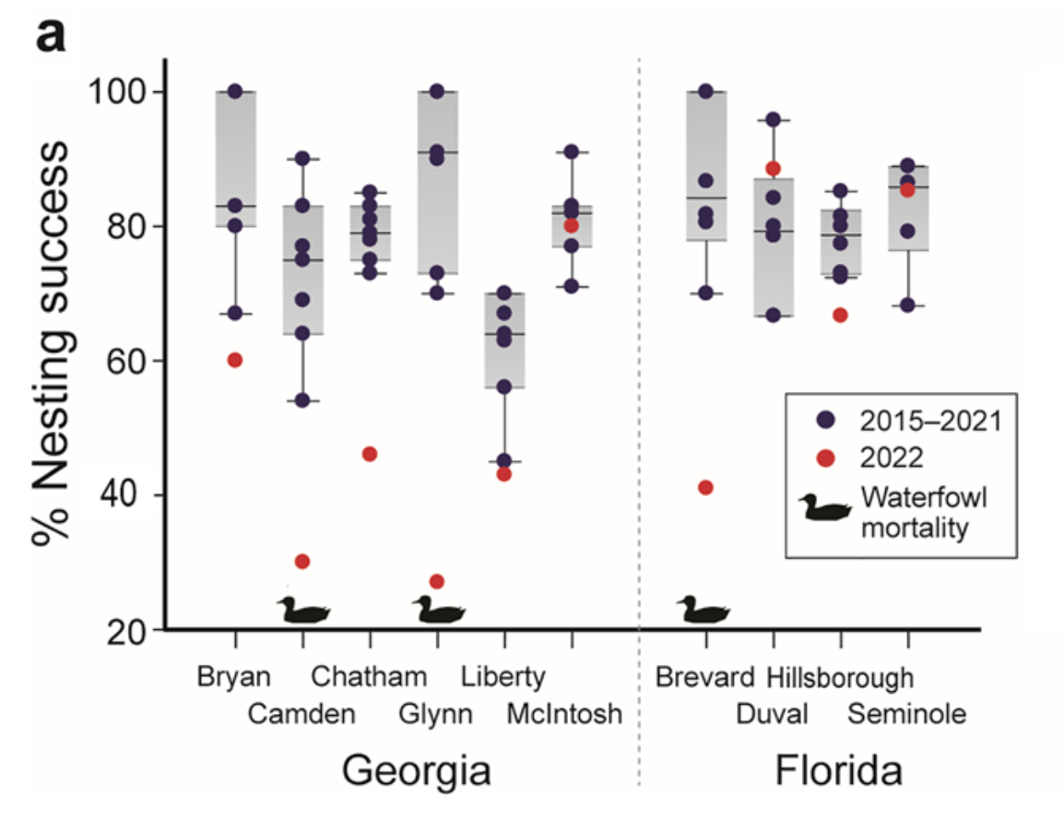
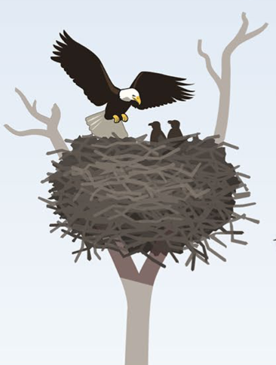
Effects of HPAI on apex predator species
Source: Nemeth et al. (2023) Sci Rept 13:191.
Notes:
A study by Nicole Nemeth has shown that in bald eagles,
the nesting success in 2022 here shown by the red dots, is significantly lower than the historic range (shown in grey).
And nesting success is particularly worse at sites where there were reports of waterfowl mortality (here marked by the duck symbols).

Slide 22
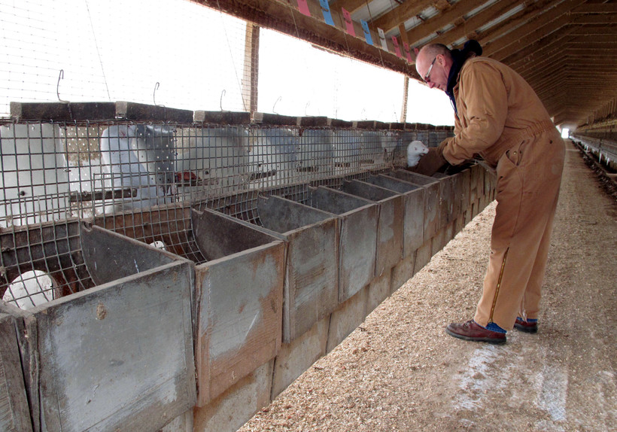
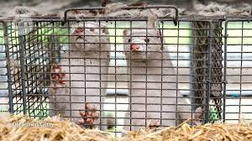
Spanish mink farm infection with HPAI H5N1
“It was really quite disturbing to us to see how open they were to the environment,” Dr. Thijs Kuiken said in a New York Time interview, “and how easy it was for both mammals and wild birds to get into these mink farms and have contact with mink.”
Source: Aguero et al. (2023. Eurosurveillance 28(3):pii=2300001)
Notes:
I could not find pictures of the Spanish mink farm, but the quote from Thijs Kuiken in the New York Times suggests that the
caging in Spain is similar to these pictures which are of a mink farm in Wisconsin.
You can see that the cages are only partially covered with a fair degree of access to wild birds and to both wild and farm animals.
Photo credit:
Mink in cages: https://www.wpr.org/after-years-tough-prices-wisconsin-mink-production-fell-60-percent-2020
Wisconsin mink farm: https://www.wpr.org/wisconsin-farms-gop-push-back-mink-industry-ban

Slide 23
Transmission on the Spanish mink farm
Implications
Possible mink to mink transmission. “Our findings also indicate that an onward transmission of the virus to other minks may have taken place in the affected farm.”
Mutations
T271A (PB2). Enhances the polymerase activity of influenza A viruses in mammalian host cells and mice.
No E627K (PB2) mutation found
I396M (NA) disrupts a second sialic acid binding site (2SBS). 2SBS is conserved in nearly all AIV but is lost in all human pandemic viruses. The disruption of 2SBS might increase binding to mammalian type receptors.
Source: Aguero et al. (2023. Eurosurveillance 28(3):pii=2300001) & De Vries and de Haan (2023. Eurosurveillance 28(7):pii=2300085).
Notes:
The authors of the report on the Spanish mink farm in Eurosurveillance, Aguero et al., was quite guarded in how they describe possible mink to mink transmission only to say that “onward transmission to other minks may have taken place.”
Subclick
The premier scientific journal, Nature, come right out and stated: “A variant of H5N1 influenza that CAN spread between mammals could pose an increased risk” of spreading to people.

Slide 24
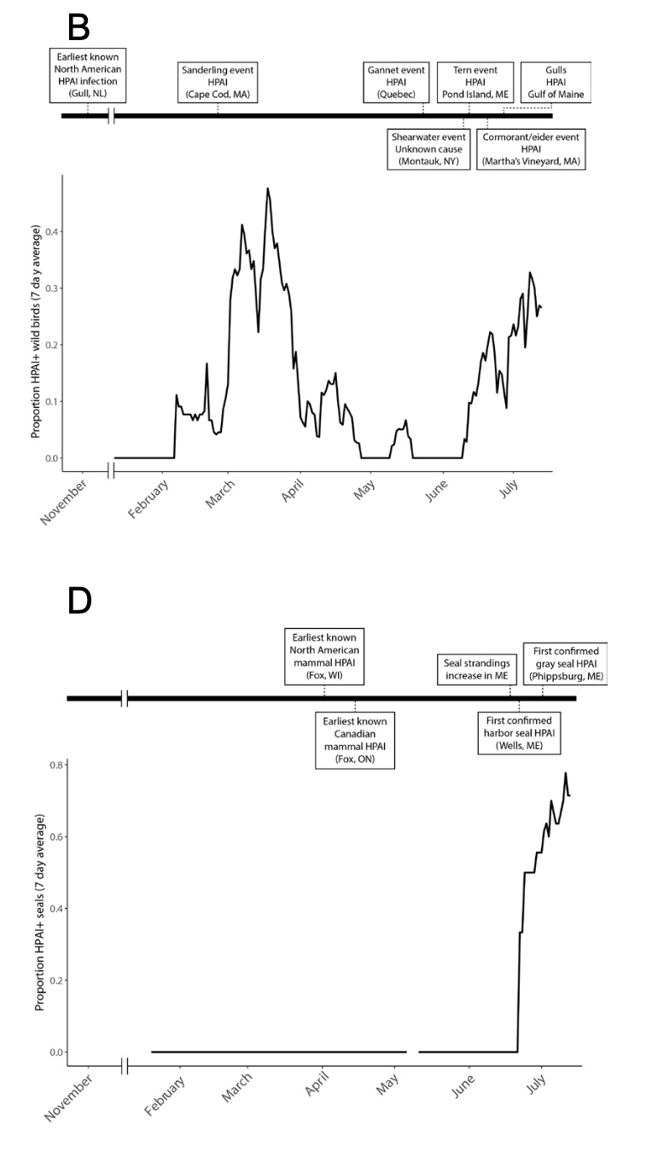
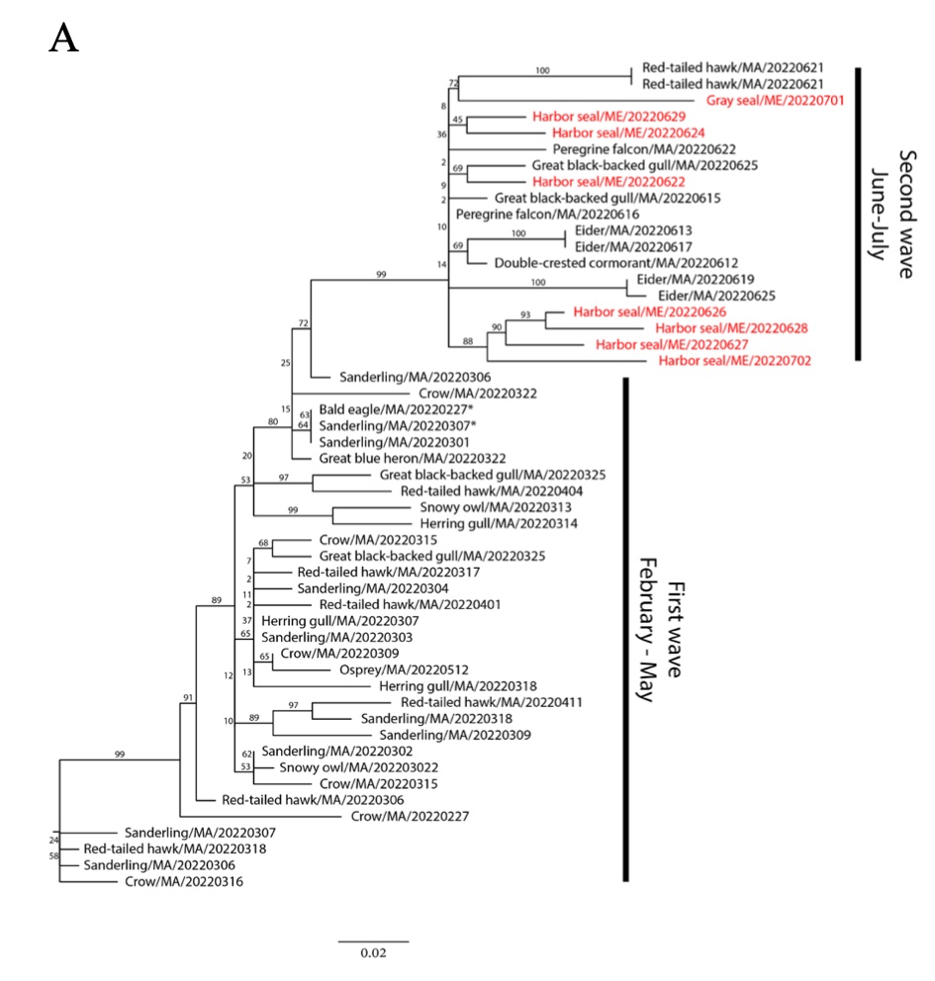
H5N1 infection in seals
Source: Puryear 2023 EID 29:786.
Preliminary Information - Subject to Revision. Not for Citation or Distribution.
Notes:
Before I give you my thoughts on the mink outbreak
Let me remind you that multiple other mammals have died due to HPAI H5N1.
In a paper that was published EID,
Puryear et al. showed that there was an increased mortality of grey and harbor seals in New England (shown on the timeline on the bottom right in panel D) occurred at a time of increasing wild bird infections that is shown on the timeline on the top right (panel B).
The viruses that they found in the seals (colored in red on the phylogenetic tree in Panel A) were closely related to H5N1 viruses identified from wild birds (shown in black) from the same area.
More interesting was their discovery of the E627K mutation in some, but not all, of the seals even if they were found stranded together.
This suggests that the E627K mutation, which was not present in the wild bird virus, emerged only during the infection process in some of the seals.
Finally, the sequences from the seals over their study area suggests that seals in different locations were affected by separate introductions from wild birds and there was no evidence of a single mammalian adapted strain that was causing the seal mortality event.

Slide 25
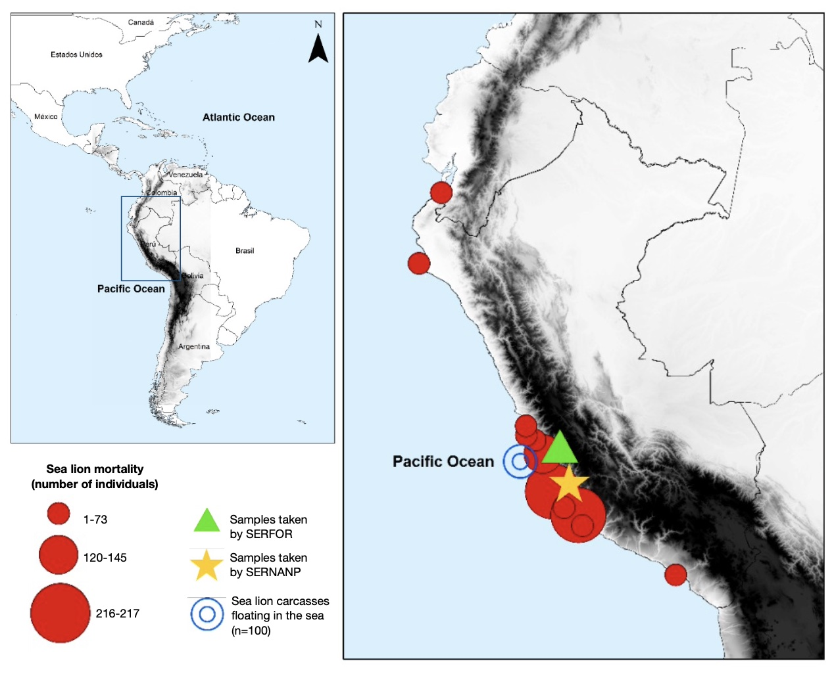
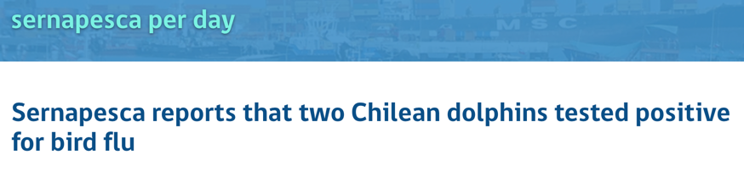
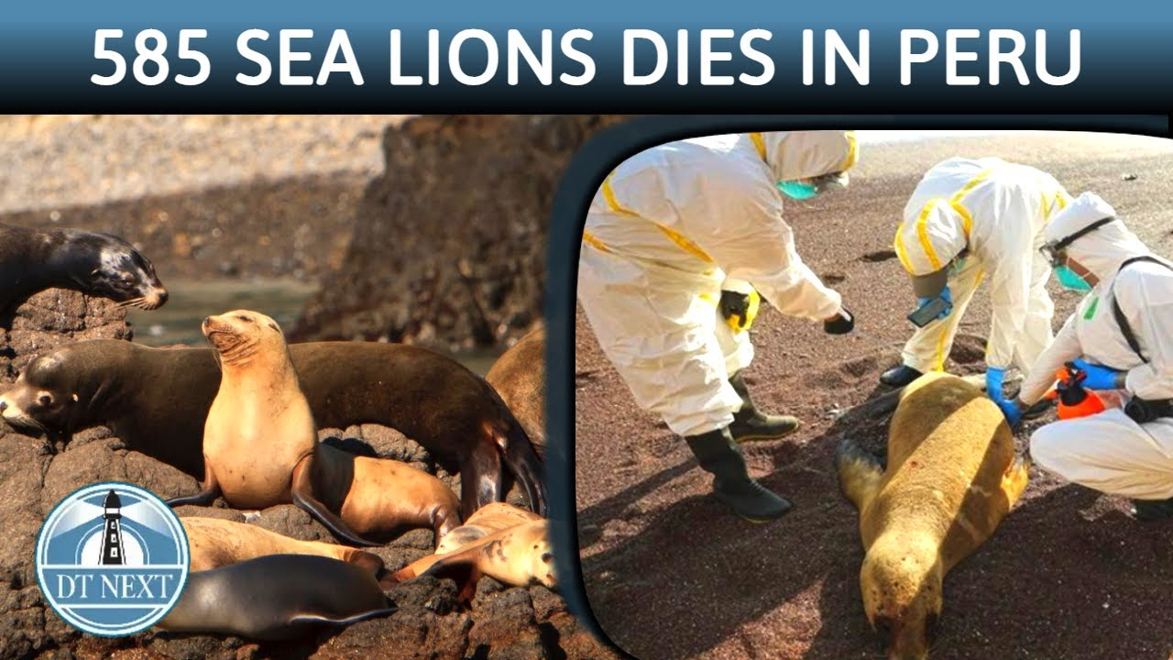
clade 2.3.4.4 b HPAI H5N1 infection in sea lions
3,347 sea lions, 958 Humboldt penguins, 16 marine otters, 15 porpoises and 11 Chilean dolphins have died in Chile
5,000
Source: Gamarra-Toledo et al.(2023. bioRxiv).
Preliminary Information - Subject to Revision. Not for Citation or Distribution.
Notes:
Another group of mammals with massed mortality from H5N1 are sea lions.
Since this slide was made, the number of sea lions that have died in Peru has increased.
As of 4/20/23, Peru estimates that 5% of the global population of South American sea lions or over 5,000 animals has died from bird flu.
and on the same day, Chile updated their numbers and reported the confirmation of H5N1 in two Chilean dolphins,
Marking yet another species of marine mammal known to be infected with H5N1.
Apparently there has not been any evidence of transmission among mammals. The sea lions are just in an environment where the viral load is very high. The situation may have been complicated by the mammals that have been weakened by a lack of food according to Paolo Amaya, a biologist at Cesar Vallejo University in Peru.
(https://www.laprensalatina.com/avian-flu-decimates-wildlife-on-south-americas-pacific-coast/).

Slide 26


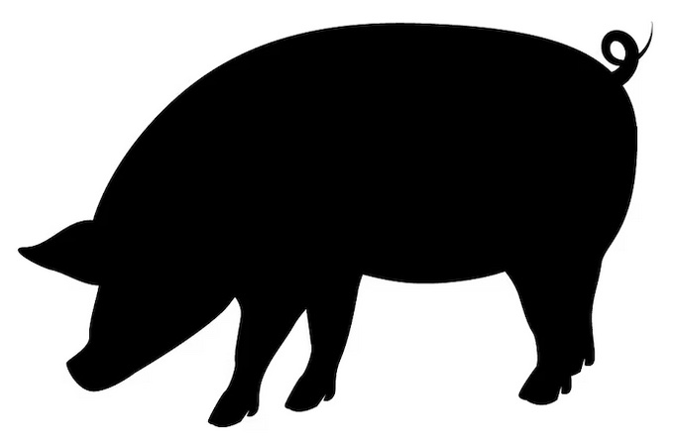

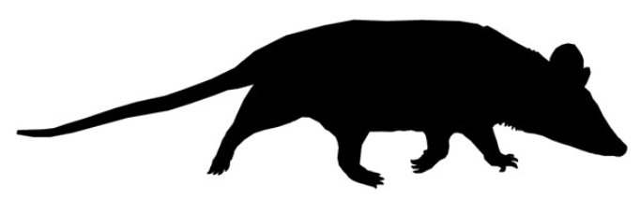


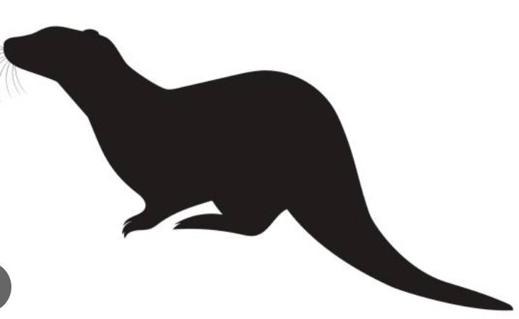

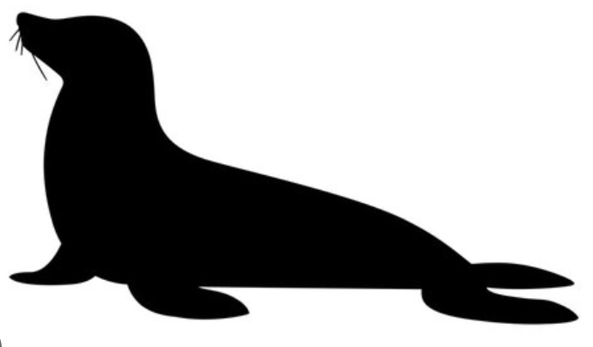
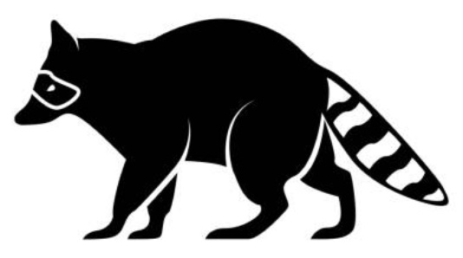

Clade 2.3.4.4b global mammalian species infected
Source: DVL
Preliminary Information - Subject to Revision. Not for Citation or Distribution.
Notes:
Globally at least 12 mammalian families in two orders have been affected by clade 2344b H5Nx viruses.
This ranges from dolphins and porpoises to foxes and raccoons and even bears.
Beside the original Guangdong H5N1, this is the widest group of mammals to be affected by a HPAI virus.
The most common species reported is the red fox. Infection in foxes have been reported from at least 11 countries.

Slide 27
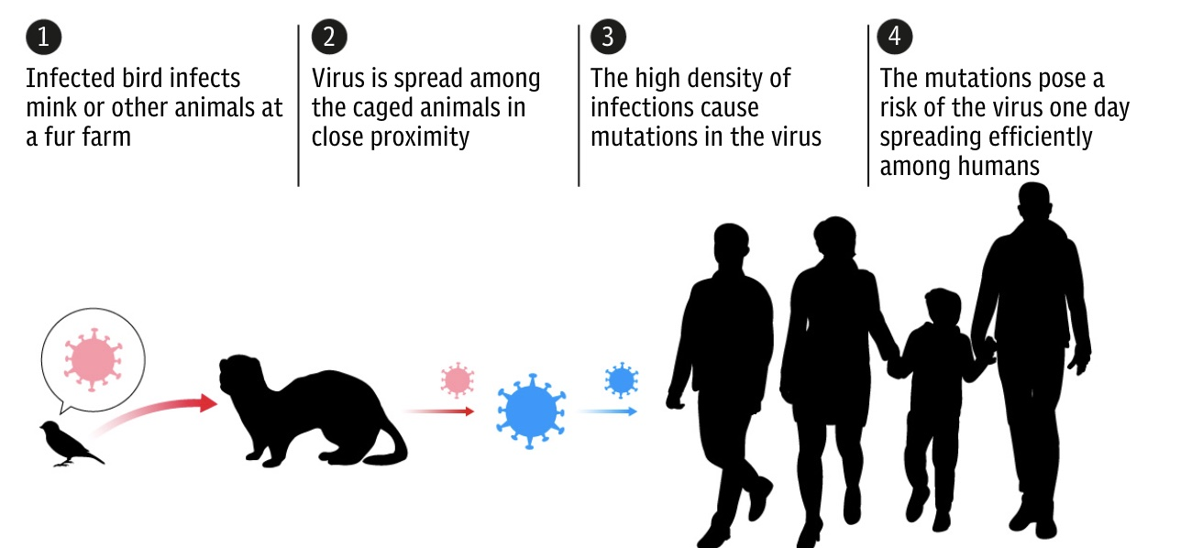
This work is licensed under a Creative Commons Attribution 4.0 International License.
Notes:
The worry from a public health agency perspective from these mammalian infections with H5N1 is whether they signal an adaption of the virus from an avian influenza virus into a human pandemic influenza virus.
But first let me tell you why I think that mass mortality events in mink and the marine mammals by avian influenza viruses does not necessarily mean that that is a virus poised to become a pandemic virus.

Slide 28

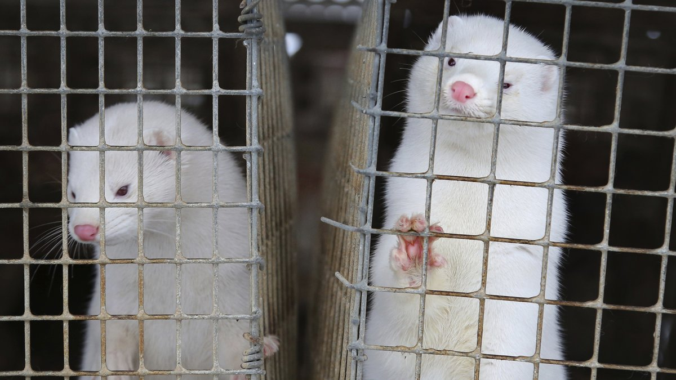
Influenza infections in mink
Seasonal Influenza
1983. h H1N1 & h H3N2. Mink farm in Japan (serology)
2009. h H3N2. 11 mink farms in Denmark
Pandemic Influenza
2010. pdm H1N1. Mink farms in Denmark
2019. pdm H1N1. Mink farm in Utah
Swine Influenza
2006. Triple reassortant sw H3N2. Mink farms in Canada
2009. h x sw H3N2. Mink farm in Denmark
2017. sw H1N1. Triple reassortant. Fatal co-infection with CDV. China
Avian Influenza
1984. Avian H10N4. Large scale outbreak on mink farms in Sweden
2013-15. Avian H9N2. Mink farms in China
2015. 2.3.2.1b & 2.3.2.1e H5N1. Mink farms in China
2022. 2.3.4.4b H5N1. Wild mink in Ontario, Canada & farmed mink in Spain
Source: DVL
Preliminary Information - Subject to Revision. Not for Citation or Distribution.
Notes:
28
One way to put the H5N1 infection in the Spanish mink farm into perspective is to look at what other influenza viruses have been found in mink.
Mink have been infected with seasonal and pandemic influenza viruses, most probably from their handlers.
Mink have been infected with different swine influenzas.
And mink have been infected with both low and high path (in red) avian influenza viruses.
Mink, and many of the animals on the previous table, are susceptible to infection with both avian and mammalian influenza viruses because their respiratory track (among other organs) posses both the avian, or alpha 2,3 sialic acid containing cell surface receptors as well as the mammalian or alpha 2,6 sialic acid containing receptors,
So in combination with the fact that they are house in close proximity to each other and in caging where exposure to wild birds and animals is possible, mink are poised to be infected with all kinds of influenza viruses. I can readily envisage a similar situation with seals, sea lions where they haul out and are in close proximity to each other and to marine birds.
Photo credit:
Wild mink: https://ag.utah.gov/2020/08/17/first-cases-of-sars-cov-2-in-mink/
Farmed mink: https://www.13abc.com/2022/11/15/vandalism-leads-40000-escaped-mink-van-wert-co/

Slide 29
What is needed to turn H5N1 into a pandemic virus?
Is there sustained human to human transmission?
Notes:
So, what does it take to turn H5N1 or any other avian influenza viruses into a pandemic virus?
In people, the alpha 2, 6 type of receptors are found in the upper respiratory tract, and this contributes to the idea that the seasonal influenza virus can readily spread via aerosol when we sneeze or cough.
Humans do have some avian or alpha 2,3-sialic acid containing receptors in our respiratory tract, but they are located deep in our lower airways, and infection with avian influenza virus only happen with prolonged contact and with a source of high viral load.
But even if we become infected, that virus has a difficult time getting out of the lower airway and spread to another person.
So as the case of the father and child in Cambodia show, infection with HPAI H5N1 can happen, but not sustained human to human transmission.
Gambotto et al., 2007. Lancet 371:1464-1475.
Figure 3: A model of the emergence of a pandemic strain by direct transmission of an avian virus
An avian influenza virus recognising SAα2,3Gal oligosaccharides and containing Glu at position 627 of its PB2
infects epithelial cells in the human lower respiratory tract, where SAα2,3Gal oligosaccharides are prevalent. For this
virus to be effi ciently transmitted in human beings, the haemagglutinin receptor specifi city will probably need to
change to recognise SAα2,6Gal oligosaccharides, which are molecules prevalent in the human upper airway (upper).
A Glu-to-Lys change at position 627 of the PB2 might also be selected, leading to enhanced replication of avian
virus in human beings. These changes and other yet unknown changes promote viral replication in the human
upper respiratory tract, leading to effi cient human-to-human transmission by coughing and sneezing (upper). Red
viral particles symbolise H5N1 particles with pandemic potential, and green particles are highly pathogenic avian
H5N1 viruses with little potential for human to human spread.

Slide 30
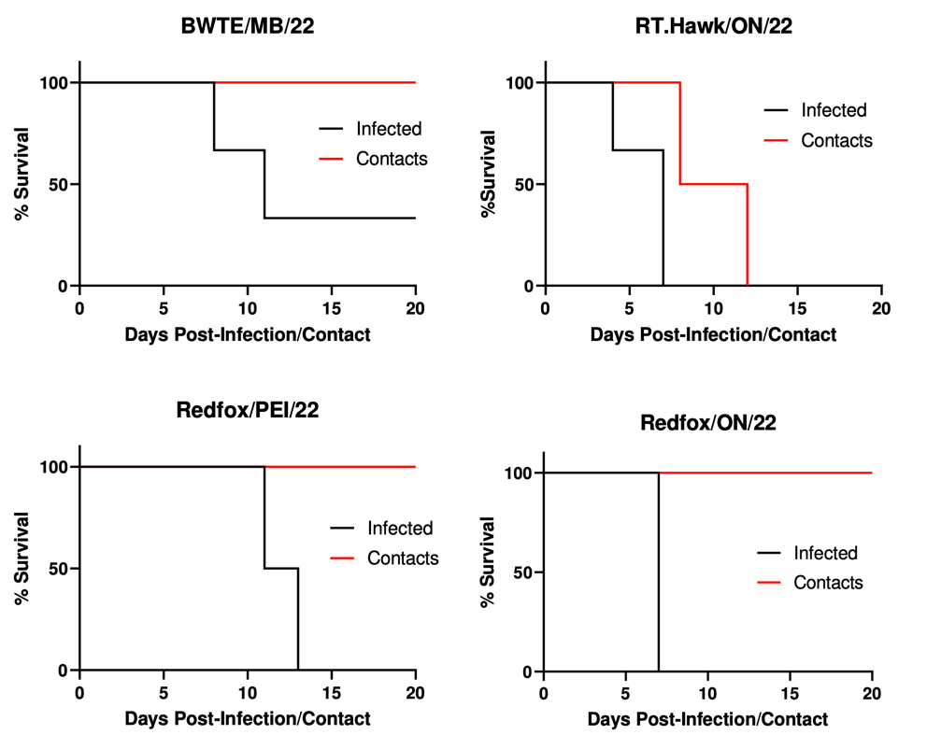
H5N1 infections in ferrets and direct contact transmission
Red Fox/PEI/22 is wholly Eurasian but has E627K
Others are reassortants
Red-tailed hawk/ON/22 has AM PB2, PB1, and NP segments
Source: Warner et al. (2023. Res Square)
Notes:
30
A Canadian study using four HPAI H5N1 strains showed that some are able to replicated in human airway cells. The RTHA replicated the best, was able cause rapid death in ferrets, and transmit the virus to contact animals and probably also capable of airborne transmission. The molecular changes are being investigated.
BWTE/MB/22 and Red fox/ON/22 both had AM (PB2, PB1, PA and NP)

Slide 31
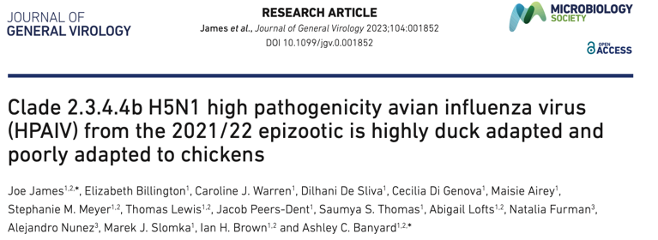
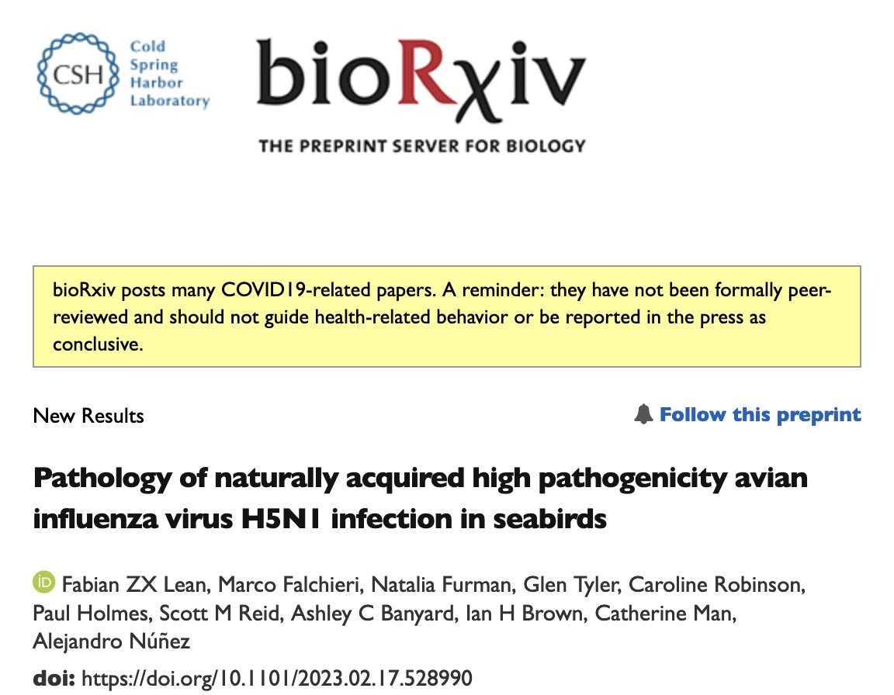
Adaptations to wild birds
txt
Source: DVL
Preliminary Information - Subject to Revision. Not for Citation or Distribution.
Notes:
What we know about clade 2.3.4.4b viruses is that they are highly adapted to ducks and much less so than chickens.
This is a study that was just recently released and is not yet peer-reviewed.
While the study used domestic ducks, I think the results has implications in terms of wild birds, especially anseriformes.
This clade 2344b virus is being sustained in wild birds without necessarily input from infected poultry.
(A second study shows that in addition to direct virulence and pathology that is seen on other HPAI infections, the 2.3.4.4b viruses have a predilection for infection of the epithelium and this is seen particularly in marine birds where their oviduct epithelium is directly targeted.)

Slide 32
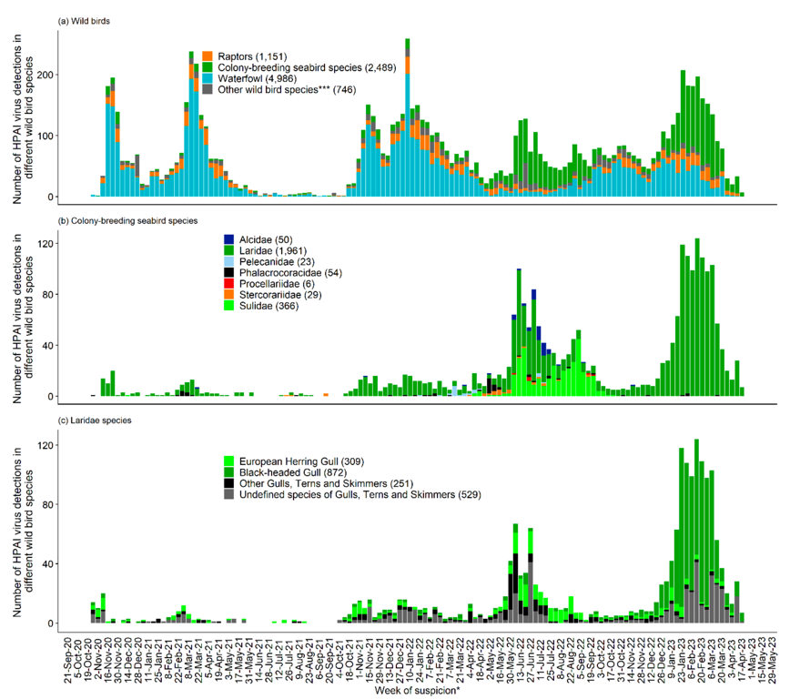
Changes in affected species
Switch from waterfowl to colonial seabirds
Source: Adlhoch et al. EFSA J 21:8039.

Slide 33
Summary
Currently clade 2.3.4.4b H5N1 viruses are adapted to ducks, incl. wild Anseriformes
(Some gene segments are exceptionally stable)
Extensive spill back and self perpetuation in wild birds
Increased exposure to mammalian predators and scavengers
Limited, mostly de novo, appearance of mammalian adaptation mutations
Transmission to humans is rare and non-sustained
"Should we keep an eyeball out for this? Yes, should we lose our mind over it? Probably not.”
James Lowe, Univ of Illinois.
Source: DVL
Preliminary Information - Subject to Revision. Not for Citation or Distribution.
Notes:
So, in summary I have shown you that the current clade of 2.3.4.4b viruses are well adapted to ducks, perhaps including the wild Anseriformes.
I did not have time to go into details, but some RNA segments seem to be retained while other segments reassort. This suggests that there is a constellation of genes that together make this virus well adapted to ducks and is being actively selected.
Because of this genetic adaptation, the transmission in wild birds seem self-perpetuating at the present time,
and no longer require continued spill back from an agricultural source the way that some earlier clades of H5N1 needed.
The increased number of wild birds infected increases the likely exposure of the HPAI virus to predators and scavengers.
We currently see only sporadic de novo appearance of mutations for mammalian adaptation, but as yet no evidence for a steady accumulation of these mutations.
Transmission to people remains rare, and when it happens human-to-human transmission is limited, if at all.
So, in the words of James Lowe. “Should we keep an eyeball out for this? Yes, should be lose our mind over it? Probably not.”

