Slide 1
Rabies Epidemiology and the Public Health Perspective Wisconsin Virology Conference, May 21, 2024
Angie Maxted, DVM, PhD, DACVPM
State Public Health Veterinarian
Wisconsin Department of Health Services
Notes:
BCD webinar for LHDs

Slide 2
Describe
Rabies in animals and humans
Rabies exposures, animal follow-up
Pre- and post-exposure prophylaxis
Notes:
The objectives for todays presentation are to
Describe how and where rabies occurs in animals and in humans
Describe rabies exposure assessment and the appropriate animal follow-up
Describe rabies pre- and post-exposure prophylaxis protocols

Slide 3
Rabies Basics
Fatal viral encephalitis caused by a rhabdovirus
Virus in neural tissue and shed in saliva
Primarily a disease of animals
Human cases reflect animal rabies distribution
Notes:
We’ll start with some rabies basics. Rabies is a zoonotic disease caused by a rhabdovirus, resulting in fatal viral encephalitis. Infectious virus is found in neural tissue and is shed in saliva. While people can become infected, it is primarily a disease of animals. Human cases are a reflection of the distribution in animals through virus spillover.
--------------------
Source: CDC Image Library; https://phil.cdc.gov/Details.aspx?pid=8341; Caption: This transmission electron microscopic (TEM) image revealed the presence of numerous dark, bullet-shaped, rabies virions within an infected tissue sample. Copyright Restrictions:None - This image is in the public domain and thus free of any copyright restrictions. As a matter of courtesy we request that the content provider be credited and notified in any public or private usage of this image.

Slide 4
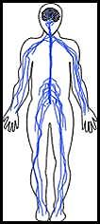
Rabies Pathogenesis
Virus transmitted via bite
Binds to and multiplies in myocytes at bite site
Highly neurotropic, enters peripheral nerves
Bite site
Notes:
Rabies virus is typically transmitted through the bite of an infected animal. The virus initially binds to and multiplies in myocytes at the bite site. The virus is highly neurotropic and enters the peripheral nerve cells by binding with the nicotinic acetylcholine receptors.

Slide 5
Rabies Pathogenesis
Virus travels in axoplasm of nerves towards central nervous system
Replicates in the brain and spinal cord; signs and symptoms of rabies exhibited
Travels to innervated organs
Salivary glands → viral excretion in saliva
Rabies virus is always in the brain before it’s in the saliva
No transmission during incubation
Bite site
Notes:
Once in the nerve, the virus then moves up the nerve cells via axonal transport towards the CNS,
<click> Then, the virus moves rapidly up and replicates in the spinal cord to the brain. This is when the person or animal will start exhibiting rabies signs and symptoms.
<click> At this point, the virus will travel back out of the CNS to various organs, including the salivary glands, resulting in the viral excretion in saliva – so the cycle could continue.
<click> an important thing to remember is that rabies virus is always in the brain before it’s in the saliva. This forms the basis of the systems to observe or test animals to determine if they could have been shedding virus in the saliva at the time of a bite.
There is no transmission during the incubation period before the virus is in the brain AND salivary glands.

Slide 6
Human Rabies Worldwide
>150 countries / territories
Tens of thousands of deaths annually
Children under 15
High burden in Africa, Asia
99% canine variant rabies
Notes:
Human rabies disease occurs worldwide in more than 150 countries and territories. It causes tens of thousands of deaths annually, most of which occur in Asia and Africa. Children under 15 are most at risk, because they are most likely to suffer dog bites. 99% of human rabies deaths are attributed to dog bites and canine variant rabies
--------------------
Source: http://www.who.int/news-room/fact-sheets/detail/rabies
Image Library: aggressive-looking-dog.jpg

Slide 7
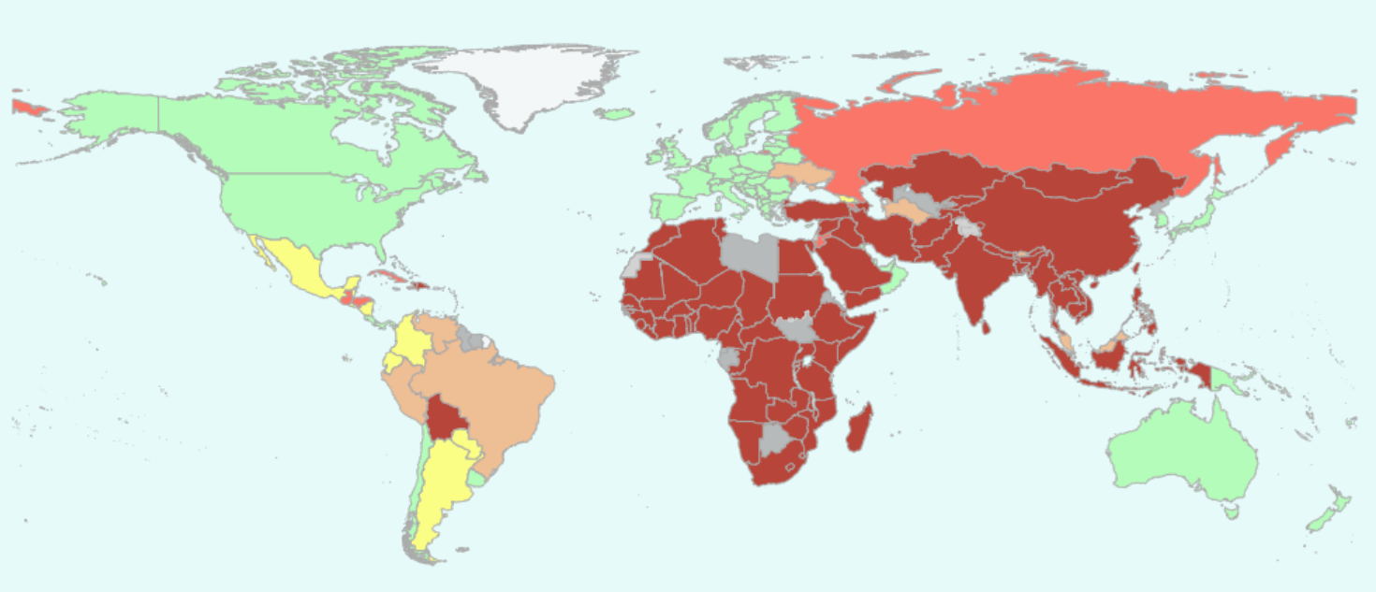
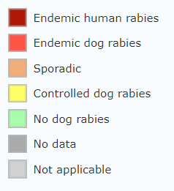
Presence of Dog-Transmitted Human Rabies 2019
Notes:
This Map from the WHO shows WHERE canine variant rabies is still endemic.
So you can see, in green and yellow, that N. America, much of central and S. America, most of Europe, Japan, Australia, New Zealand and a few other countries have eliminated or controlled dog rabies.
You should notice the dark orange and red areas, where dog rabies is endemic and causing endemic human cases from dog transmission.
______________
http://www.who.int/rabies/Presence_dog_transmitted_human_Rabies_2014.png?ua=1
Presence of dog-transmitted human rabies based on the most recent data point from different sources, 2010-2014 – WHO

Slide 8
Rabies Reservoirs and Vectors
Bridge Vector
Notes:
As we’ve said, dogs act as a domestic animal reservoir for rabies – canine variant.
However, there are also vast wildlife reservoirs for rabies viruses. We think of these in 2 groups – bat rabies, and “terrestrial” rabies. Of terrestrial rabies, the main reservoirs are mesocarnivores or “middle-sized” carnivore species – animals such as skunks, raccoons, foxes, etc. We worry about any of these reservoirs being a direct source of transmission to humans.
<click>In areas of the world where canine variant rabies has been eliminated – such as the US – domestic animals such as dogs, cats, and livestock can be bridge vectors – meaning that they can bring wildlife rabies close to humans – or bridge that gap between wildlife and humans that normally wouldn’t contact each other.
Domestic animal reservoir: dogs (canine variant)
Wildlife reservoirs: vast
Bat rabies
Terrestrial rabies – mesocarnivores (skunks, raccoons, foxes, etc.)
In areas where canine rabies has been eliminated, domestic animals (dogs, cats, livestock) can be bridge vectors
Bridge the gap between wildlife and humans

Slide 9
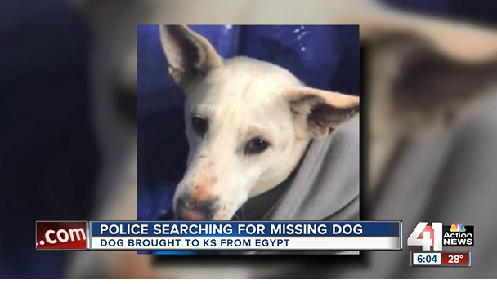
Source: https://www.kshb.com/news
Source: https://www.gwinnettcounty.com
Notes:
Well, Even if we don’t consider our endemic rabies risk- we live in a world where people AND animals are constantly crossing international borders – and there’s always the risk of reintroduction.
<click> for example, In 2019 a group of dogs were rescued from Egypt and brought to the US for adoption. These animals came in legally and apparently with documentation of rabies vaccination. Despite that, one of the animals broke with rabies not long after arriving and resulted in the entire group of dogs needing to be quarantined.
<click> We also know that even dogs born/raised in this country and vaccinated can sometimes get rabies. Although rabies vaccines for animals are very very good, no vaccine is 100% effective. This is a story from 2018 in Georgia where a vaccinated dog was infected with rabies.
and there are a lot of factors that may way in to if a vaccinated dog gets rabies – maybe the exposure was prior to vaccination, maybe the animal had only a single dose and then had a large exposure with not booster – so these things do happen.
----------------------
https://www.kshb.com/news/local-news/dog-imported-from-egypt-by-kansas-shelter-infected-with-rabies-others-quarantined
https://www.gwinnettcounty.com/web/gwinnett/NewsandEvents/NewsDetails?news=PressReleases/BOYBITTENBYRABIDDOGNEARSTONEMOUNTAININGWI

Slide 10
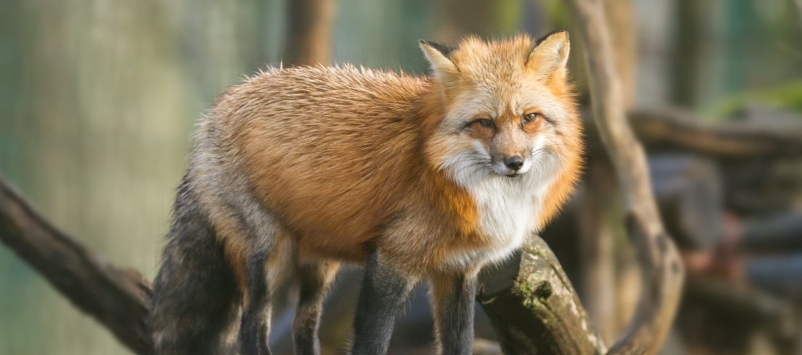
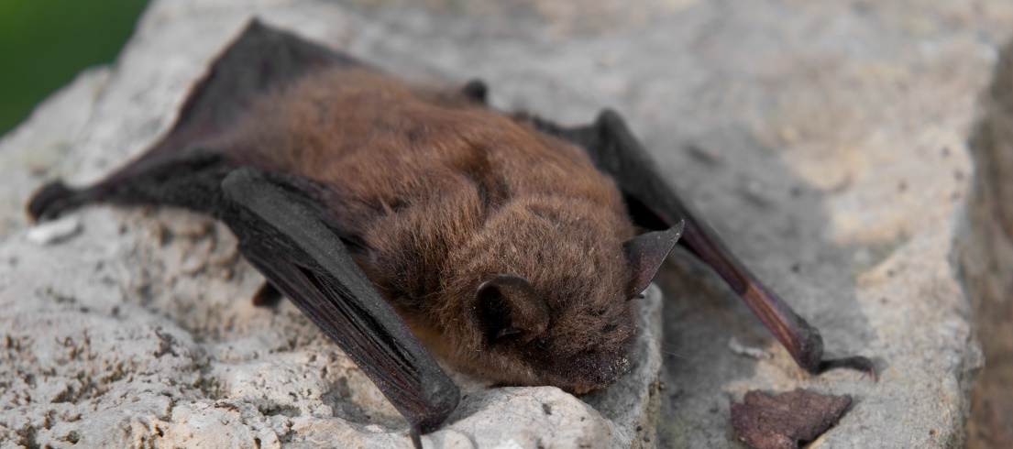
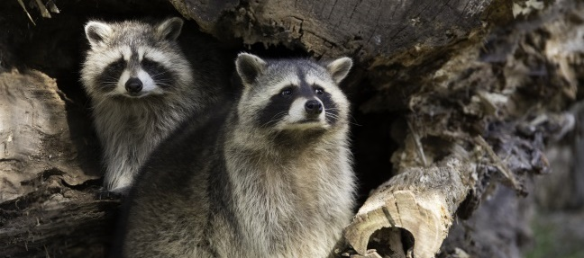
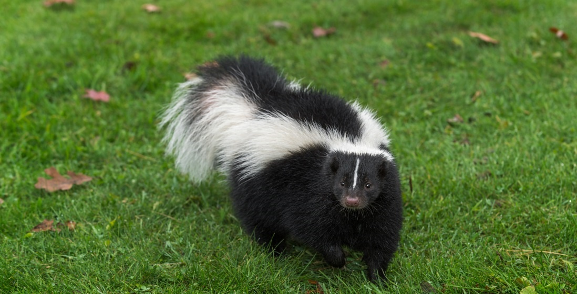
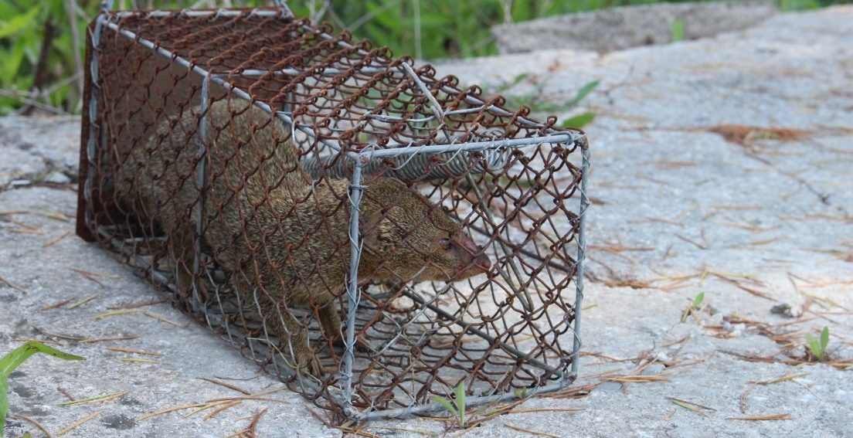
U.S. Wildlife Reservoirs
Notes:
As I’ve alluded to, canine variant rabies has been eliminated from the US, but we still do have wildlife reservoirs of the disease.
in And then of course the other reason we still need to be concerned about rabies here in the US - even though we’ve addressed dog rabies - is because we do have wildlife reservoirs that pose a risk to people and our domestic animals
Bats, foxes, Raccoons, skunk, and mongoose are the major wildlife reservoirs in the US and US Territories
-------------------
https://www.shutterstock.com/image-photo/little-brown-bat-104917853?src=M7QiwlX-sL9cVPMlYF15AQ-1-0 = little brown bat
https://www.shutterstock.com/image-photo/little-brown-bat-myotis-lucifugus-side-76642096?src=M7QiwlX-sL9cVPMlYF15AQ-1-6 = little brown bat
https://www.shutterstock.com/image-photo/red-fox-animal-789989680?src=2gGZQY7Hhli6E9Eno5pZDA-1-4 = red fox
https://www.shutterstock.com/image-photo/striped-skunk-mephitis-walks-forward-captive-756323242?src=Eh6LYUQ9xV8qiKaNlhUrDg-1-3 = skunk

Slide 11
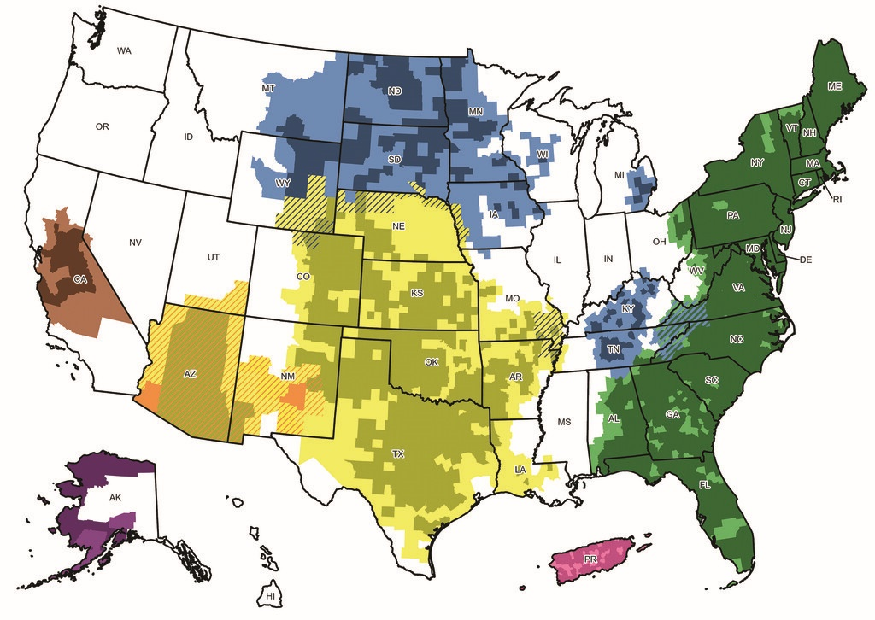
Distribution of Terrestrial Rabies Virus Variants 2017-2021
N Central Skunk
CA Skunk
Raccoon
AZ Fox
S Central Skunk
Arctic Fox
Mongoose
Notes:
This map shows where the major terrestrial (nonbat) rabies variants are distributed among species in the US. You can see that raccoon rabies is prevalent up and down the eastern coast of the US and Skunk rabies runs north/south through the center of the US and as well as in CA.
Fox variants are found in the southwest AZ-NM-UT as well as in arctic fox variant in Alaska. Puerto Rico has mongoose variant.
And bat rabies is found throughout the continental US. No bat rabies in AK, HI, or PR and some of the Caribbean.
Bats were the only rabid animals detected in 8 states (Iowa, Idaho, Illinois, Indiana, Mississippi, Oregon, Washington, and Wisconsin)
J Am Vet Med Assoc. 2022 May 5;260(10):1157-1165. https://doi.org/10.2460/javma.22.03.0112
Rabies surveillance in the United States during 2020
Xiaoyue Ma MPHhjv4@cdc.gov¹, Sarah Bonaparte MPH¹, Matthew Toro MS¹, Lillian A. Orciari MS¹, Crystal M. Gigante PhD¹, Jordona D. Kirby MS², Richard B. Chipman MS², Christine Fehlner-Gardiner PhD³, Veronica Gutiérrez Cedillo PhD⁴, Nidia Aréchiga-Ceballos PhD⁵, Agam K. Rao MD¹, Brett W. Petersen MD¹, and Ryan M. Wallace DVMeuk5@cdc.gov¹
View More
DOI: https://doi.org/10.2460/javma.22.03.0112
Volume/Issue: Volume 260: Issue 10
Online Publication Date: 05 May 2022

Slide 12
Significant Decline in Human Rabies Cases Since 1945
U.S. Declared Canine-variant Rabies Free in 2007
1945: 43 human deaths
WI 2004
WI 2010
WI 1959
WI 2000
Notes:
And unfortunately people in the US die each year from rabies. This graph shows HUMAN cases of rabies in the US since 1945 (post WWII) when there were 43 human deaths that year. There is dramatic drop in cases between 1945 and 1965 with most years since then having less than 5 cases each year.
A major reason for the decline is the mass vaccination of dogs that began in the 1940s. The US was declared free of canine variant rabies in 2007 after years with no cases.
<click> human rabies cases in Wisconsin are marked by the red boxes. So while rare yes- its not zero and means we have to remain vigilant and take exposures seriously.
WI Cases
1959
2000 – removed bats from home with bare hands several times/year
2004 – Rabies survivor (bat)
2010 – bat strain; no reported bite but bats in the woodpile
https://www.cdc.gov/media/pressrel/2007/r070907.htm ; US Declared Canine-Rabies Free CDC Announces at Inaugural World Rabies Day Symposium

Slide 13
Place Acquired and Rabies Virus Variant of US Human Rabies Patients, 2000-2021
69% Within the US
31%
Outside of the US
N=49
Excludes 5 organ transplant patients

Slide 14
Animal Rabies in Wisconsin

Slide 15
Animal Rabies in Wisconsin Wildlife and Domestic Animals, 1962–2023
1981
1981: 332 Animal Cases 2023: 37 Animal Cases
Notes:
In Wisconsin, Looking over a 60 period, the number of rabid animals has declined dramatically from a peak of 332 in 1981 (skunk outbreak) to fewer than 30 last year- which you can see we have been relatively stable in terms of number over the last several decades.
*19 cases of animal rabies in 2018, DOES NOT include 6 non-native vampire bats from the NWHC

Slide 16
Animal Rabies in Wisconsin Wildlife and Domestic Animals, 1962–2023
1989–2023
Notes:
If we want to look more closely at the species breakdown during this period since 1989….

Slide 17
Animal Rabies By Species, Wisconsin 1989–2023
Bats
Cattle, horses, raccoons, etc.
Calf
Other
Dogs
Fox
Cat
Skunks
Notes:
You can see that in the late 80’s and early 90’s rabid skunk and other wild animals were more common, but since the 2000’s positive bats have accounted for most of the animal cases.
Recent rabies-positive species other than bats and skunks include a dog, fox, cow and cat. You can see that the number of “other” animals positive is more closely associated with the trend in skunks, which is typical since these other species are terrestrial and live on the ground with skunks.
It’s not fully known why skunk cases have not been detected recently, but note that we have seen skunk rabies in other species including domestic animals during years when it has been detected in skunks.
Last cat: 2017
Last cow: 2015
Last fox: 2014
Last dog: 2009
Last horse: 2002
Last raccoon: 1996

Slide 18
Rabies-Tested Animal Species Wisconsin, 2014-2023
Muskrat, squirrel, opossum, woodchuck, goat, mink, coyote, sheep, rabbit, wolf, deer, weasel, ferret, shrew, bear, bobcat, zoo animals, etc.
N=19,949
Notes:
But if we compare that to the number of animals submitted during that time frame on the next slide….
It’s a much different distribution of species. Again, this is the breakdown by species of all animals tested during the last 10 years. Although bats are most commonly tested (39% of the animals tested), dogs and cats make up about half of the animals tested. Why? Because these are the animals most likely to be involved in a bite exposure to a human or another domestic animal.
Other tested species include raccoons, cattle, skunks, horses and foxes, which are known rabies vector species or those that have tested positive in the past. About 4.5% of testing is made up of the remaining species, which include muskrat, squirrel, opossum, woodchuck, goat, mink, coyote, and others.

Slide 19
Animal Rabies Cases, 2018-2022
Douglas
Bayfield
Iron
Washburn
Sawyer
Ashland
Price
Vilas
Burnett
Oneida
Florence
Number of Cases N=121
 | 0
 | 1
 | 2-4
 | 5-10
 | 11-44
Polk
Barron
Rusk
Marinette
Lincoln
Forest
Chippewa
Taylor
Langlade
Oconto
St. Croix
Dunn
Marathon
Menominee
Clark
Pierce
Eau Claire
Pepin
Shawano
Door
Buffalo
Wood
Portage
Waupaca
Outagamie
Kewaunee
Species:
Bats (N=121)
Big brown bat (n=101)
Jackson
Brown
Trempealeau
Monroe
Juneau
Waushara
Winnebago
Manitowoc
LaCrosse
Adams
Marquette
Calumet
Green Lake
Fond du Lac
Sheboygan
Vernon
Richland
Sauk
Columbia
Dodge
Ozaukee
Crawford
Dane
Washington
Grant
Iowa
Jefferson
Waukesha
Milwaukee
LaFayette
Green
Rock
Walworth
Racine
Data Source: Wisconsin State Laboratory of Hygiene
Kenosha
Notes:
Big brown bat (101)
Silver-haired bat (6)
Little brown bat (5)
Hoary bat (4)
Mexican free-tailed bat (3)
Cave myotis (1)
Unknown (1)

Slide 20
Prevention and Management of Potential Exposures
Notes:
Now let’s talk about rabies prevention and management of potential human exposures.
https://www.shutterstock.com/image-photo/rabies-virus-vaccine-396069187?src=bwtF4WWU0CSszqZF7UDslw-1-17

Slide 21
Public Health Goals
Prevent Human Rabies
Avoid Unnecessary RPEP
Notes:
Our main goals from a public health standpoint are, of course, to prevent human rabies.
But another goal is to avoid or eliminate unnecessary rabies post-exposure prophylaxis, through public health coordination of animal follow-up such as observation and quarantine.

Slide 22
What are our Prevention Tools?
Animal bite prevention (domestic and wild animals, bat exclusion)
Animal vaccination programs
Human pre-exposure vaccination (PrEP)
Bite wound management
Follow-up of offending animals to determine rabies status
Rabies post-exposure prophylaxis (RPEP)

Slide 23
Rabies Pre-Exposure Vaccination
For more information about pre-exposure vaccination www.cdc.gov/rabies/specific_groups/travelers/pre-exposure_vaccinations.html
Notes:
First, Rabies pre-exposure vaccination There are several reasons why rabies pre-exposure vaccination could be administered. First, it simplifies the PEP course needed after a rabies exposure, and second, it’s likely to provide some protection against an unrecognized rabies exposure in someone who is at risk. It’s also likely to provide some protection in situations where initiation of PEP may be delayed after an exposure.
Rabies pre-exposure is recommended for:
Veterinarians and staff, animal handlers, rabies researchers, some laboratory workers who might have contact with rabies virus,
Persons who have frequent contact with potentially rabid animals (bats, raccoons, skunks, cats, dogs, etc.), and
Some international travelers (delay in getting PEP, potency of biologics)
For more information…
ACIP: Rabies Pre-Exposure Prophylaxis
Pre-exposure rabies prophylaxis is administered for several reasons. (1) although pre-exposure vaccination does not eliminate the need for additional medical evaluation after a rabies exposure, it simplifies management by eliminating the need for RIG and decreasing the number of doses of vaccine needed. This is particularly important for persons at high risk for being exposed to rabies in areas where modern immunizing products might not be available or where cruder, less safe biologics might be used, placing the exposed person at increased risk for adverse events. Second, pre-exposure prophylaxis might offer partial immunity to persons whose postexposure prophylaxis is delayed. Finally, pre-exposure prophylaxis might provide some protection to persons at risk for unrecognized exposures to rabies.
Pre-exposure Vx should be offered to people in high-risk groups, such as veterinarians and their staff, animal handlers, rabies researchers, and certain laboratory workers. Pre-exposure vaccination also should be considered for who are frequently in contact with rabies virus or potentially rabid animals like bats, raccoons, skunks, cats, dogs. In addition, some international travelers might be candidates for pre-exposure vaccination if they are likely to come in contact with animals in areas where dog or other animal rabies is enzootic OR if immediate access to appropriate medical care, including rabies vaccine and immune globulin, might be limited. Routine pre-exposure prophylaxis for the general U.S. population or routine travelers to areas where rabies is not enzootic is not recommended

Slide 24
!
People who have been vaccinated still need rabies post-exposure prophylaxis (RPEP) after a recognized exposure
Notes:
This is very important: people who have been vaccinated against rabies, whether pre-or post-exposure, still need post-exposure prophylaxis after a recognized rabies exposure. It does not eliminate the need for RPEP. It is CRITICAL that people who are vaccinated know that they canNOT skip PEP after a new exposure. Even if someone had recently been tested and had high titers. PEP is still indicated following an exposure, but the series is modified (we will cover this later).

Slide 25
Animal Bite Next Steps
Follow-up of offending animal
Rabies post-exposure prophylaxis
Rabies exposure assessment
Notes:
Very often this is when a patient will present themselves – either because of a bite wound requiring medical attention, or because they have had an encounter with an animal and are specifically worried about rabies. The next steps in an animal bite situation are to 1) conduct a rabies exposure assessment, 2) work with the local health jurisdiction, animal control, law enforcement agency or whomever is charged with doing that so they can follow-up with the offending animal and determine its rabies status. Then, if necessary, Rabies PEP may be needed.

Slide 26
Rabies Exposure Assessment
!
Not every bite is a rabies exposure, but rabies exposure must be ruled out for every bite
Evaluate
Animal species
Circumstances of the bite
If the animal is available
Notes:
As part of the rabies exposure assessment, I like to think of it this way: not every bite is a rabies exposure, but rabies exposure needs to be ruled out for every bite. Some things to consider are
the animal species and whether it’s a species where there is a rabies risk
The circumstances of the bite and whether the animal’s behavior was within normal limits at the time, or if the animal was displaying unusual behavior or signs of neurologic disease
And whether the animal is available for testing or might be found within a few days of the encounter.
Note that vaccination status of domestic animals is not considered in the above, and we’ll cover this in a bit.

Slide 27
What Constitutes an Exposure?
Requires the presence of infective virus, typically in saliva
Also neural tissue and cerebrospinal fluid (CSF)
The virus must come into contact with a bite wound, other open wound (scratch, abrasion), or mucosal surface
Bite exposure
Non-bite exposure
Notes:
We’ll now talk about what constitutes a potential EXPOSURE to rabies – this is important to understand so people who need PEP can get it.
For an exposure to occur you need the infectious virus to be present – MOST OFTEN this is via the saliva, but in addition to saliva neural tissue and cerebrospinal fluid or CSF is also condidered potentially infectious – and this again makes sense if you remember the pathophysiology and the viruses affinity to moving into the CNS
THEN you need that infectious material to gain access to myocytes or nervous tissue in the body – so again saliva in a bite wound is far and away the most common route of an exposure; but it could also be exposure of an infectious material to a wound, a scratch/abrasion to the skin or a mucosal surface like in the eyes or mouth.
We typically breakdown potential exposures by bite and non-bite. Bites are pretty straight forward – essentially any bite from a Mammal is a potential exposure because saliva is injected into the body.
Human rabies from non-bite exposures are rare, but possible. Include scratches, abrasions, open wounds or mucus membranes that are exposed to saliva or other potentially infectious material from a rabid animal. These can also be harder to assess.
The more difficult exposures to assess are the non-bites;
It is possible, but rare, for people to get rabies from non-bite exposures, which can include scratches, abrasions, open wounds or mucus membranes that are exposed to saliva or other potentially infectious material from a rabid animal. These can be harder to assess– they are also often situation where we can’t definitively say one way or the other if an exposure occurred (did a saliva splash to the eye occur? Maybe); so the patient needs to have a discussion with their provider; I would say in most cases when in doubt we lean towards recommending PEP since rabies is uniformly fatal.
Generally you can consider the virus inactive if the material is dried or dessicated; Casual contact, such as touching a person with rabies or contact with non-infectious fluid or tissue (urine, blood, feces), is not associated with risk for infection. Contact with someone who is receiving rabies vaccination does not constitute rabies exposure, does not pose a risk for infection, and does not require postexposure prophylaxis. Other types of contact, such as petting a rabid animal

Slide 28
Not Exposures
Contact with blood, urine, feces, or skunk spray
Contact with dried saliva - rabies virus is noninfectious when dried
Situations where no animal was seen, felt, or found
Notes:
It’s also helpful to talk about what are not exposures:
Contact with blood, urine, feces, or skunk spray – because virus is not found in these materials,
Contact with dried saliva – Rabies virus is noninfectious when dried, and
Skin marks of unknown origin where no animal was seen, felt, or found

Slide 29
Why the Concern About Bat Exposures?
Rationale: The majority of US rabies patients infected with bat variant had no definite history of a bite (a bite went unreported or unnoticed)

Slide 30
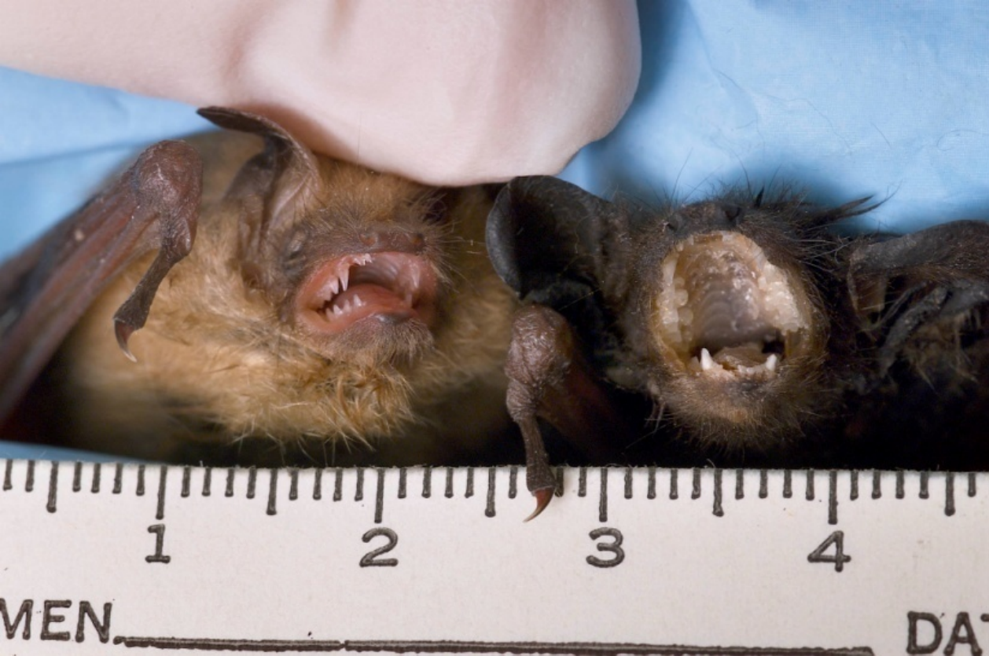
Photo Credit: CDC

Slide 31
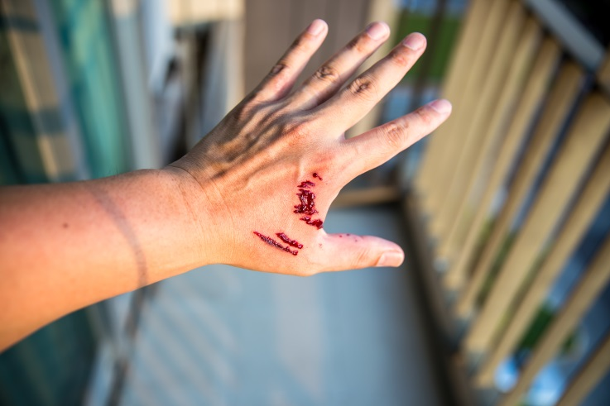
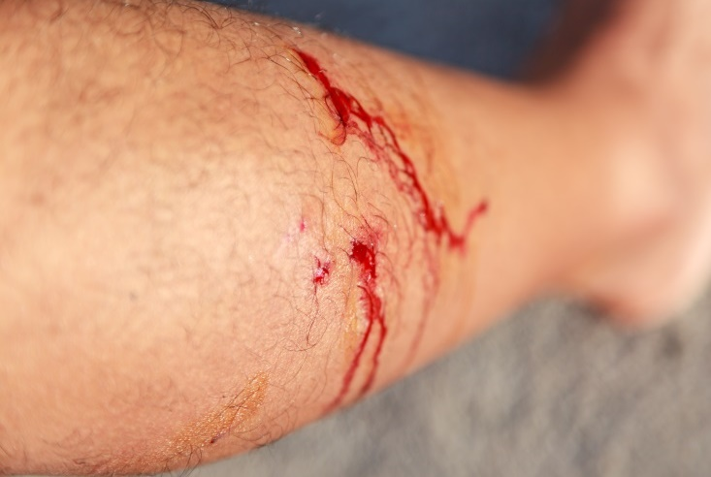
Compare These Bites
Wound inflicted by canine teeth of Eptesicus fuscus (big brown bat) while bat was being handled; picture taken same day as bite
Photo Credit: CDC
Notes:
If we compare these bites – the bat bite on the left and the bite of a larger animal on the right – maybe a dog or a fox or a skunk – it’s easy to think that the person on the right might seek medical attention for the wounds. Or that the wounds might be noticed by a friend or a loved one. Or that the person might tell someone about the scary encounter they just had with an animal.
But the tiny bite wound on the left isn’t likely to drive someone to seek medical care – if they didn’t know the risk of rabies from a bat bite. Or maybe it was just a little pinch that didn’t bother them much. And likely a friend or loved one would never notice this little red spot.
So, it’s quite likely that bat bites often go unreported.

Slide 32
Bat Exposures
Consider RPEP if direct contact occurred and a bite or scratch with saliva contamination cannot be ruled out
Consider RPEP when a person has been in close physical proximity to a bat and physical contact cannot be ruled out. Examples:
A sleeping person awakens to find a bat in the same room
An adult witnesses a bat in the same room with a previously unattended child
A bat is found in the same room with someone who can’t competently report what happened such as an intoxicated person
Unless bat is negative upon lab testing
Notes:
Bat exposures are handled a little differently, however. Because the majority of rabies patients with bat variants in the U.S. had no definite history of a bite, we suspect that bite or scratch likely went unreported or unnoticed by others.
<click> PEP should be considered for anyone who had direct physical contact and can’t explicitly rule out a bite or scratch
<click> PEP should also be considered when a person has been in close physical proximity to a bat and physical contact cannot be ruled out. Some examples are A sleeping person awakens to find a bat in the room; An adult witnesses a bat in the room with a previously unattended child; A bat is found in a room with someone who can’t competently report what happened such as an intoxicated person.
<click> And of course, if the bat test negative, then RPEP is not needed.
Bats: Direct contact with a bat where a bite cannot be ruled out
Bat in same room as a sleeping or impaired person, or unattended young child

Slide 33
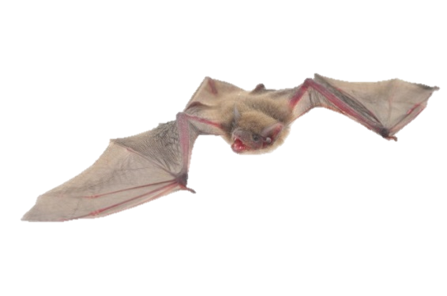
Bat Exposures – Not Exposures
Bite can be ruled out
Being near a bat, or in the same room or home as a bat
RPEP is not routinely advised for entire household
Notes:
What isn’t an exposure is being in a room as an awake competent adult if we know we didn’t have any physical contact.
Also, rabies PEP is not routine advised for everyone in the household – only those people who meet the criteria of an exposure such as being asleep or intoxicated in the same room as a rabid or suspected bat was found.

Slide 34
There has been an Exposure - When is RPEP Recommended?
If animal is available for follow-up, follow-up with the animal
10-day observation
Testing
Exceptions
RPEP recommended when
Animal tests positive (or indeterminate)
Animal is not available (and is risky species or circumstance)

Slide 35
www.dhs.wisconsin.gov/rabies/algorithm/index.htm
Notes:
I want to point out that all of the information on the previous few slides is available on our website in a form of an algorithm. You can click through the screens that cover the type of exposure, the species involved, and whether the animal is available or not to arrive at the next steps and whether RPEP is recommended or not.
Bookmark this page!

Slide 36
Rabies Post-Exposure Prophylaxis (RPEP)
For persons not previously vaccinated
For previously vaccinated persons*
HRIG
Bite
Day 0
Day 3
Day 7
Day 14
Exposure
Vaccine
Day 0 is the day the first dose of vaccine is given. It is not always the same day as the bite or exposure.
Bite
Day 0
Day 3
Exposure

Slide 37
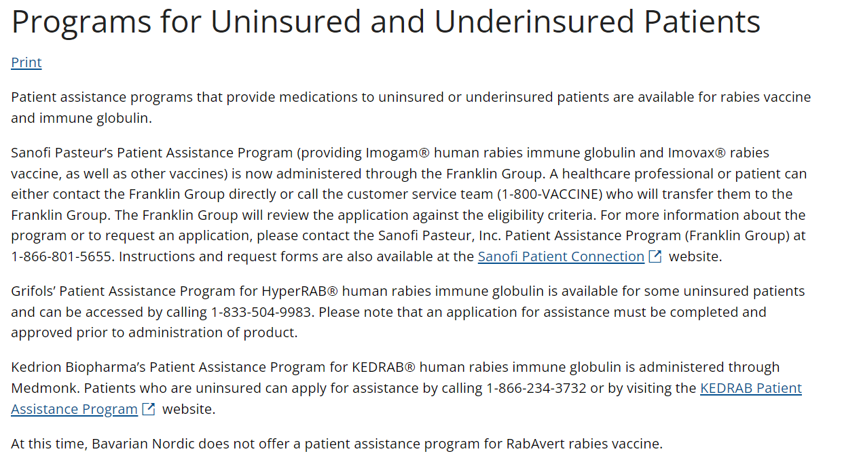
Patient Assistance Programs
https://www.cdc.gov/rabies/medical_care/programs.html
Notes:
I also want to mention that there are patient assistance programs available to uninsured and underinsured patients who need RPEP but can’t afford it. Here’s a screen shot of CDC’s website on the issue. These programs are offered directly from the biologics’ manufacturers and usually require approval prior to administration of the product.

Slide 38
What happens when a specimen tests positive for rabies?

Slide 39
Notification of Positive Results
WSLH Laboratory staff reach key partners immediately BY PHONE:
Local health jurisdiction listed on the requisition form
Physician listed on the requisition form
Veterinarian listed on the requisition form
DATCP and DHS
WSLH do not contact the bite victim/exposed person directly
Notes:
Not trying to steal the SLH’s thunder here. But the lab with reach out to several folks by phone, including the LHD, the physician, and the veterinarian listed on the requisition form. They also let staff at DATCP and DHS know too. The lab does not contact the exposed person or people directly though.

Slide 40
Public Health Follow-up on Positive Results
Immediate notification of the exposed person or owner
Verification of who handled or had potential exposure to the positive animal
For human exposures, if not already started, ensure RPEP is initiated ASAP
For animal exposures
Ensure the appropriate quarantine is issued (60 or 180 days)
If not already done, ensure animal receives rabies vaccine
Consider if additional notification or messaging to the public is warranted
Notes:
So for those of you that receive positive results, the first step is to immediately notify anyone who was known to be exposed and the animal’s owner.
<click> Also, is critically important to verify and identify every person (and every domestic animal) that had potential exposure to the positive animal for an individual risk assessment.
<click> It can’t be assumed that the requisition form is complete or accurate, and there may be additional exposures identified. it’s also important that the whole exposure history is determined – if the animal moved through multiple hands or facilities, be sure to talk to each person to assess exposure risk.
ALSO CRITICALLY IMPORTANT is to also consider and identify whether any domestic animals have been exposed so that they can be quarantined if needed. This is an expectation of local health jurisdictions to do in parallel with the human exposure investigation.

Slide 41
Important Resources
Maintain a list of local health jurisdictions, animal control, police or sheriff’s departments, veterinarians, other partners
Division of Public Health, Bureau of Communicable Disease 608-267-9003 (after hours consultation available)
DATCP, Yvonne Bellay 608-516-2664
WI State Laboratory of Hygiene 800-862-1013
Wisconsin Rabies Algorithm: www.dhs.wisconsin.gov/communicable/Rabies/RabiesAlgorithm/Index.htm
Wisconsin Rabies Website: https://www.dhs.wisconsin.gov/rabies/index.htm
Rabies ACIP Vaccine Recommendations: https://www.cdc.gov/vaccines/hcp/acip-recs/vacc-specific/rabies.html
Patient Assistance Programs: https://www.cdc.gov/rabies/medical_care/programs.html
Notes:
Finally, here is a list of importance resources to identify and to keep handy. Keep a list of the contact information for local health jurisdictions and the police or sheriff's departments, perhaps also local veterinarians, animal shelters, animal control, or anyone else involved in rabies control in or near your local jurisdiction.
I’ve also provided numbers and web links to various resources at the state level.
Emergency after hours: 608-258-0099 This is not for the general public!

Slide 42
Questions?
Angela.Maxted@Wisconsin.gov
Main line: 608-267-9003

